Slide 1
‘Work Not Worry’ Staff Webinar

Slide 2
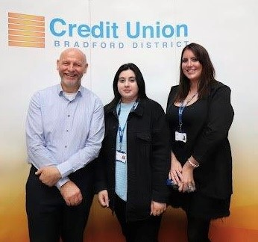
Meet The Team
Ian Brewer is EDI Community Development Lead with an international community development background. Ian leads on partnership community development projects to tackle poverty and manages employer engagement with its 34 payroll partner companies
Siobhan Graham is EDI Community Development Officer with a background in the NHS and runs the Community Development Projects as well works with Ian on payroll partnerships
Fizza Mumtaz is Marketing Apprentice working with the team to manage the website and creating marketing materials

Slide 3
Bradford District Credit Union
History
1993 - Recession led to Bradford Council launching Industrial Credit Union
2005 - Extended to all residents of Bradford
2016 - Early adopter of online banking (app in 2018)
2016 - Council funded Financial Inclusion Officer
2019 - Extended to serve Kirklees & Craven (1.5 million people)
Membership Growth
1993 - 2016 = 3000 members
2016 - 2023 = 10,000 members
We help 3000+ financially excluded members
Provide ‘Faith Friendly’ ethical savings
How Much do 10,000 members Save?

Slide 4
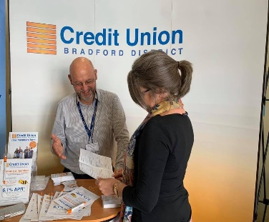
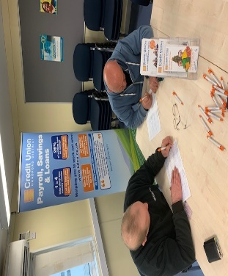
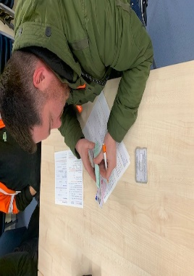
Workforce Payroll Savings
The Barriers
1 in 4 staff have major money worries
1 in 8 staff live in poverty unknown to employers
82% of workers have turned to high-cost credit
Alarming rise of Loan Shark use reported
Low credit score is a barrier to affordable loans
The Solutions
Financial Wellbeing improves performance
4,000 staff ‘Save & Borrow’ at 34 companies
Staff save £4.9 million and borrow £2 million
Loans build ‘Credit Scores’ alongside savings
Staff saving help us lend to financially excluded

Slide 5
Helping 4000+ Staff Save & Borrow
At 34 Company Saving Schemes

Slide 6
Some of our Products and Services
Christmas Savers Junior Savers £500 Family Loan
* We offer loans from £200 up to £15,000
* Savings protected upto £85,000 FScS

Slide 7
Our Community Partners
Community Development Projects
and Case Studies

Slide 8
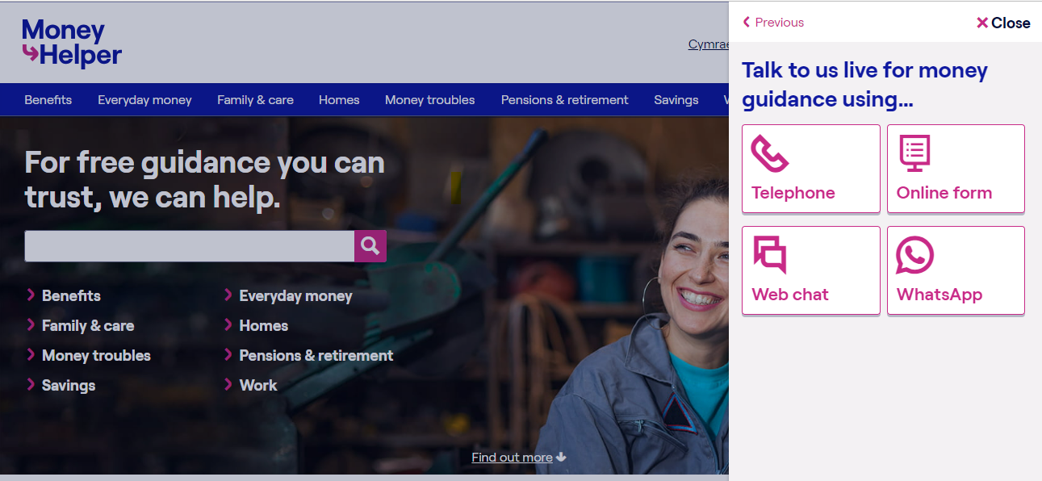
Partner with MaPS for Financial Wellbeing

Slide 9
Mind in Bradford
Partner with Mind in Bradford for Mental Health Help
We are you local mental health charity here in Bradford. Providing free mental health support to anyone struggling with their mental health and wellbeing.
We are one of over 120 independent local Mind charities throughout England and Wales. Our neighbor Minds include Leeds Mind and Manchester Mind.
mindinbradford.org.uk
Website: www.mindinbradford.org.uk
Email: admin@mindinbradford.org.uk
Address: Kenburgh House, 28 Manor Row, Bradford, BD1 4QU

Slide 10
Partner with ‘Stop Loan Shark’ Team
Over 1 million victims use loan sharks who lend without APR or permission from the Financial Conduct Authority (FCA) and use threats to get as much money out of their victims as possible. They work on estates and in the workplace!

Slide 11
Our Community Projects
Community Development Projects
and Case Studies

Slide 12
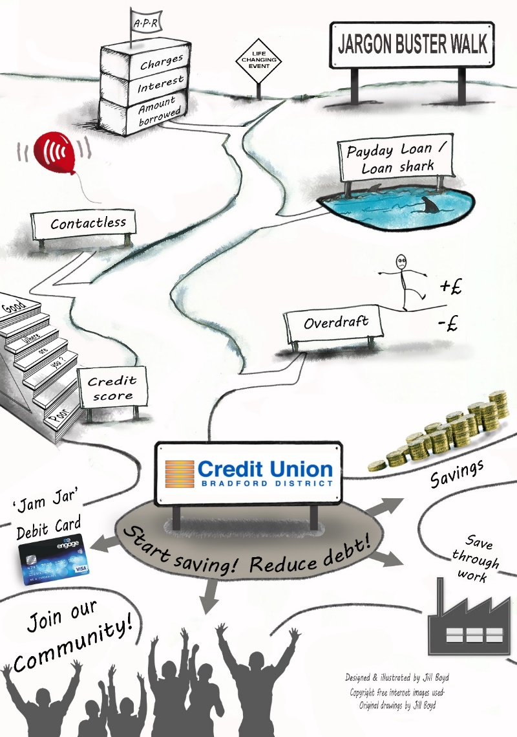
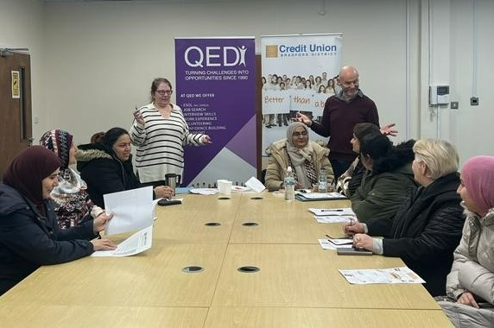
Financial Help and Workshops
‘Money SOS’ Workshop
What is APR?
PayDay and High Cost Lenders
Dangers of Loan Sharks
How Contactless Works
Overdrafts and direct debits
Improving your Credit Score
What the Credit Union offers

Slide 13
Upcoming Training
MaPS Pensions & Savings Webinar | Wed 27th March 10-11am | Teams | All payroll webinar Pension & Money Webinar (BDCU Payrolls) Tickets, Wed 27 Mar 2024 at 10:00 | Eventbrite
Money SOS NHS and Community Practitioners | Thur 2nd May 9.00 -10.00 | BRI Field House, Teaching Room 1 | All 3 NHS trusts, community and payroll partners Money SOS ‘Train the Trainer' for Community Practitioners & NHS Staff @ BRI Tickets, Thu 2 May 2024 at 09:00 | Eventbrite

Slide 14
Learning from America
‘Making financial inclusion a priority at your Credit Union is not only a “feel-good” thing to do, it’s an effective business strategy, its in our DNA.’ (Scott Butterfield ‘Your Credit Union Partner’ USA)
Community Development is at the heart of serving low-income communities that have limited access to safe financial services (Inclusiv)
Visit to USA in August 2022 to share the Bradford Model.

Slide 15
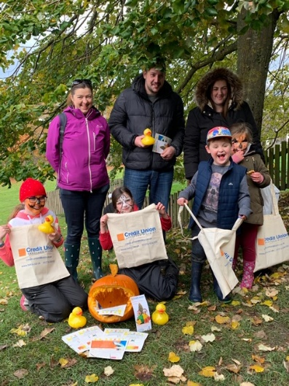
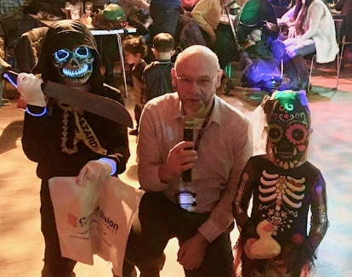
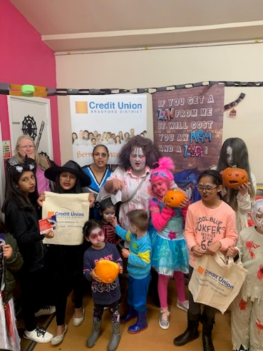
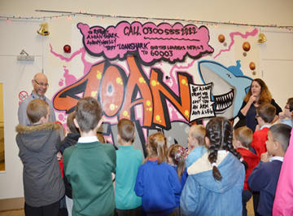
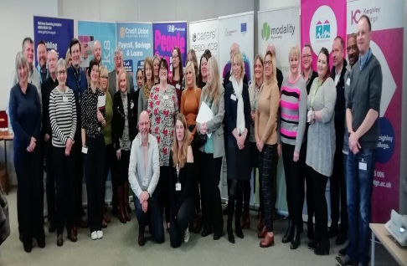
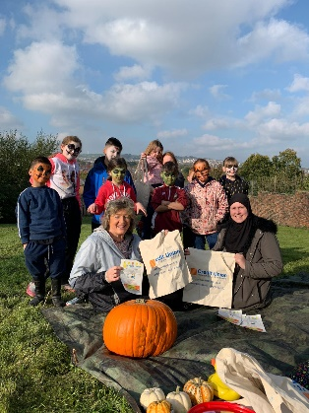
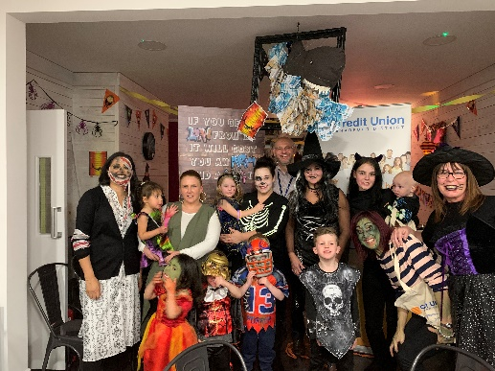
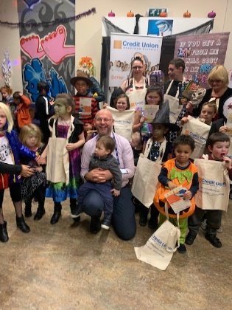
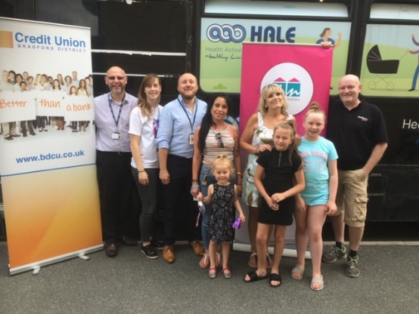
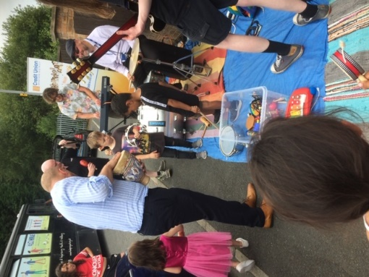
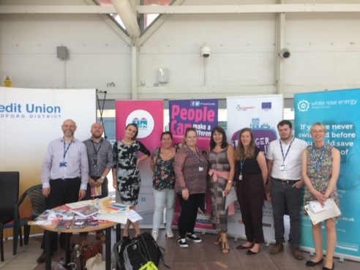
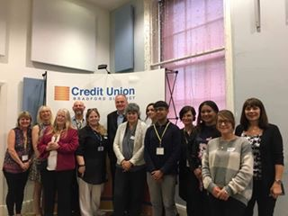
BDCU Led Partnership Projects
Conferences - Workshops - Road Shows

Slide 16
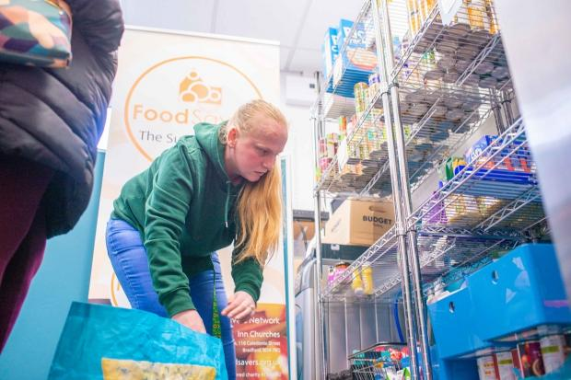
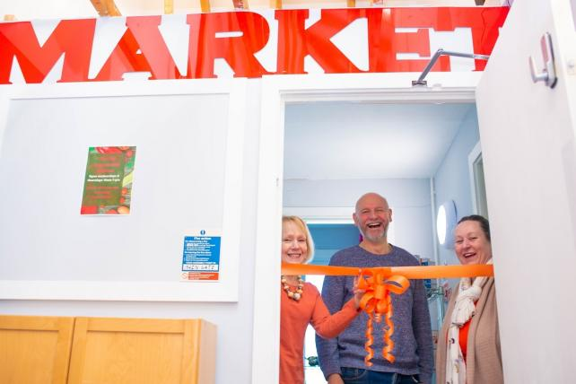
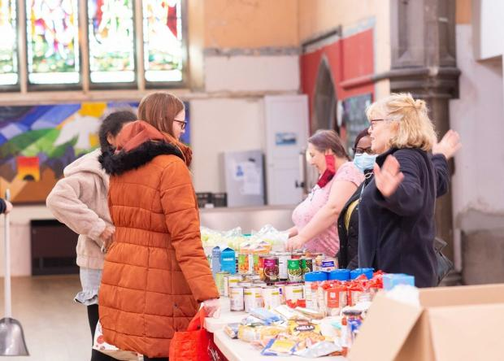
FoodSavers
Co-designed partnership project to tackle food insecurity AND save into the credit union funded by Bradford Council.
Partnered with main FoodBank provider (own the ‘FoodSavers’ name) set up pantries to tackle ‘Free Food’ dependency, providing dignity and self respect purchasing food whilst building savings.
People pay £6 per bag of chosen food worth £30 and £1 goes into the BDCU. ‘Game Changer’ as many saved more.
18 pantries
540 savers
Total Savings £52k!!!

Slide 17
£120k Funding from WYCA and Bradford Council for two new projects:
£200 microloan scheme for people with poor credit score. Started as ‘Back to School Loan’ and now ‘Home Energy Bills Support Loan’
UniformSavers #3 to help more people save for school uniforms.

Slide 18
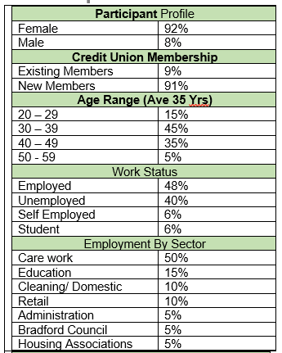
UniformSavers Public Health Project
Co-designed partnership project to tackle the ‘Cost of Living Crisis’ with Public Health Bradford to provide 285 savings accounts with a £100 bonus paid in August 2022.
Key feature was partnering with the Customer Service Centre for resolving issues and providing support ‘changed the conversation’ enhancing council’s image and boosting staff morale.
UniformSavers #3 has been funded to launch January 2024

Slide 19
Benefits of a Credit Union:
Start a savings habit from your wage without missing it
Internet and Smartphone Banking, Debit Card & Post Office
Same day withdrawals to your bank
Access to affordable loans paid back via payroll
All our loans build ‘Credit Scores’ alongside savings
Christmas Savers – Budget for Christmas
Junior Savers – Save for a child or grandchild
Faith Friendly – Halal dividend NOT interest on savings
Ethical banking that supports your community
‘Money SOS’ Workshops and MoneyTips on our website
Regular newsletter and staff loan offers for staff

Slide 20
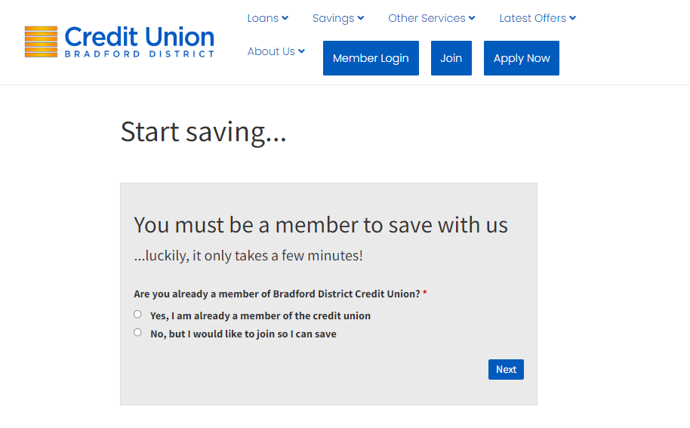
Join Today at www.bdcu.co.uk

Slide 21
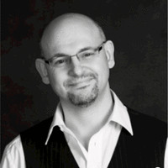
Contact
Join at www.bdcu.co.uk
Ian Brewer ian.brewer@bdcu.co.uk
Financial Inclusion Development Officer
City Hall Reception, Bradford, BD1 1HY
07533 547187

