Slide 2
Mind in Bradford
We are you local mental health charity here in Bradford. Providing free mental health support to anyone struggling with their mental health and wellbeing.
We are one of over 120 independent local Mind charities throughout England and Wales. Our neighbor Minds include Leeds Mind and Manchester Mind.
mindinbradford.org.uk

Slide 3
Why do we exist?
1 in 4 people will experience a mental health problem of some kind each year in England​.
1 in 6 people report experiencing a common mental health problem (like anxiety and depression) in any given week in England.
No one should experience a mental health problem alone, that’s why we’re here to help every day of the year!

Slide 4
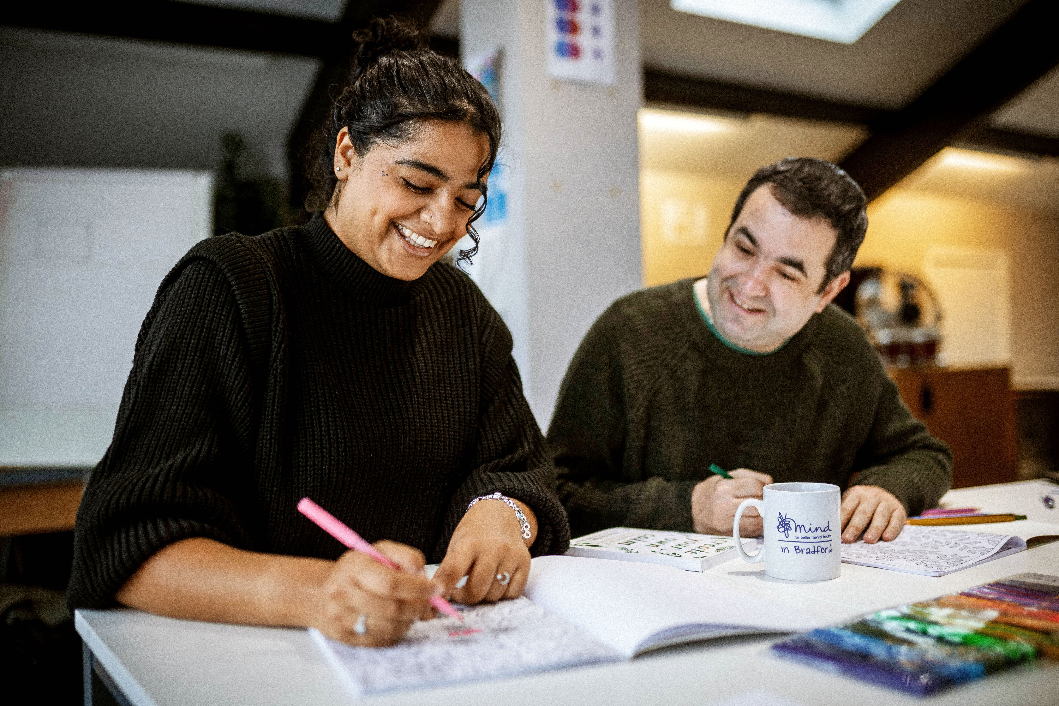
Support for you
Over 10 different services provided over the phone, in-person or online.
Talk to us over the phone or online with Guide-Line, everyday from 8am-midnight
If you’re in mental health distress, we can provide urgent support with Safe Spaces
Join our weekly wellbeing and recovery groups for adults

Slide 5
Further support
Children and Young People aged 5-25 can access our Youth in Mind programme including 1:1 and group support.
You can book up to three appointments with a Mind Recovery Worker in your local GP with Enhanced Access.
We provide support to people who hear voices.
We provide 8 other services, head to the website to find out more.

Slide 6
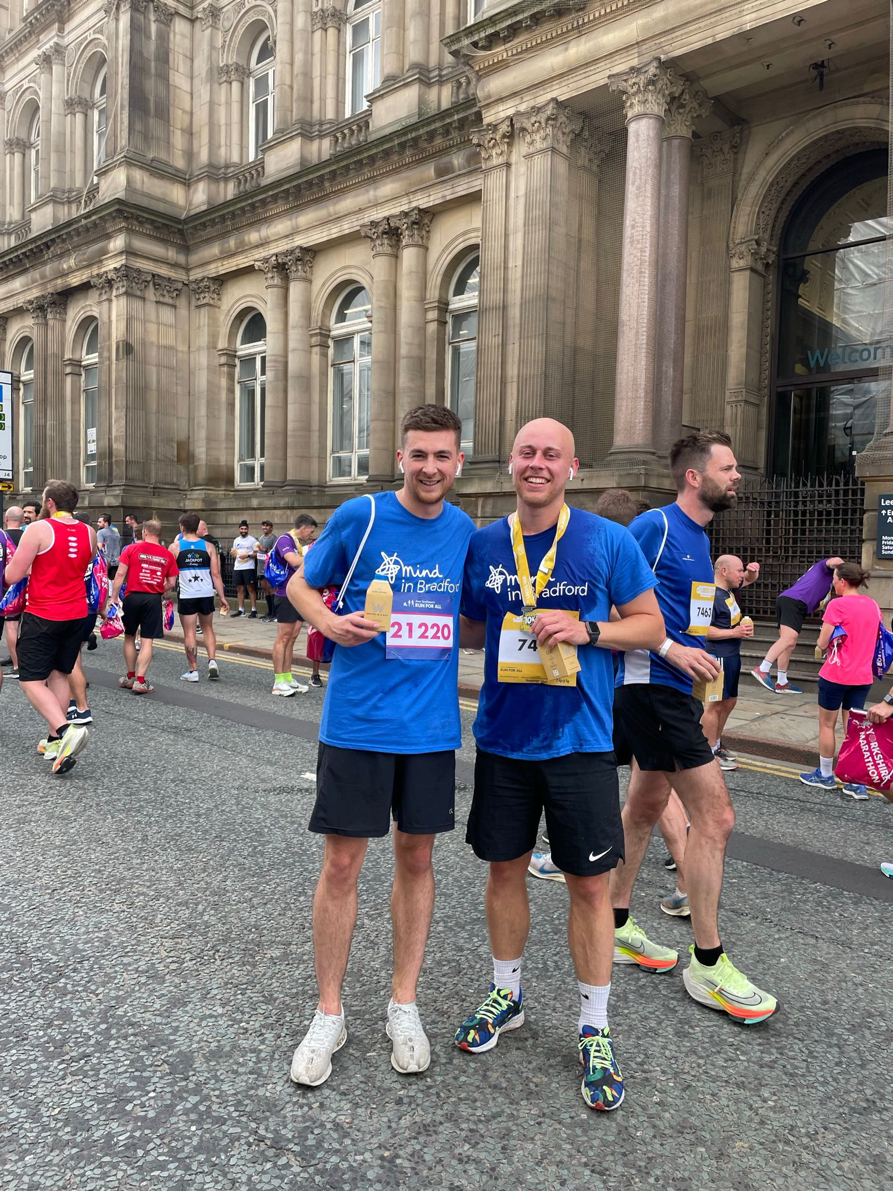
Get involved!
Volunteer
We have lots of events where you can help us fundraise or services you can work on in your spare time to build up your CV.
Fundraise
Why not take on a fundraising challenge. We have a full calendar of events on the website or do your own thing!
Work for us
We have over 100 staff working full-time and part-time at Mind in Bradford.

Slide 7
Talk to us
Call Guide-Line for emotional support on 08001 884 884
Call Mind in Bradford reception for information on
our services on 01274 730 815
Chat online
www.mindinbradford.org.uk/chat
Website: www.mindinbradford.org.uk
Email: admin@mindinbradford.org.uk
Address: Kenburgh House, 28 Manor Row, Bradford, BD1 4QU
Follow us:

