Slide 1
Yorkshire and Humber
Support for those impacted by gambling related harms

Slide 2
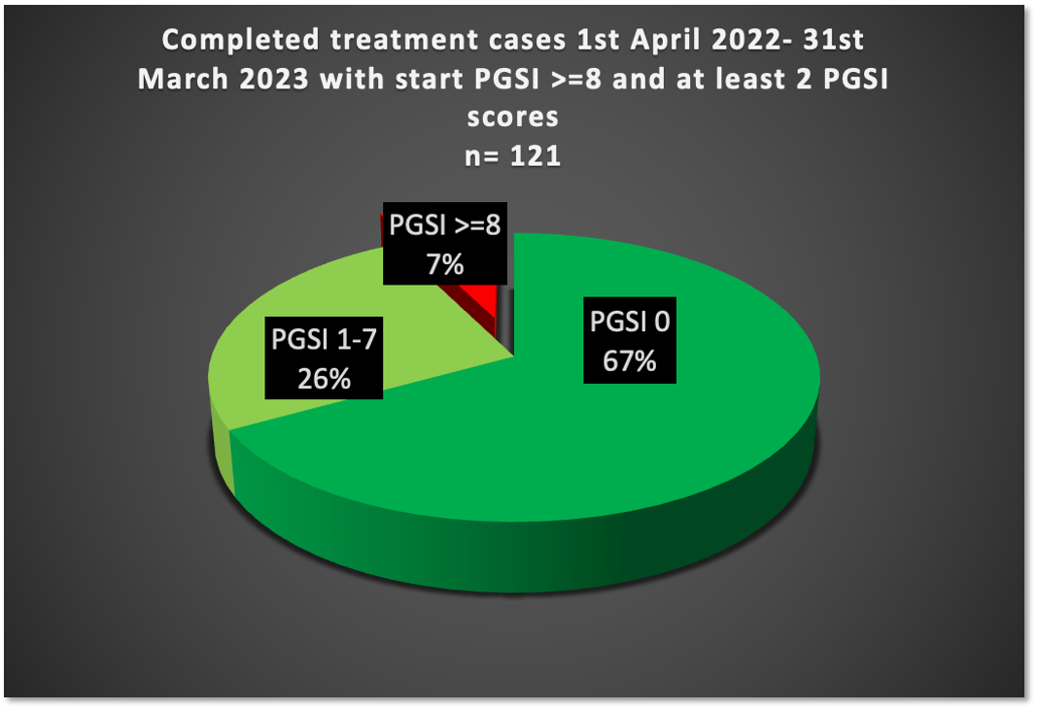
Gambling Statistics
60% of adults living in Great Britain reported participating in a gambling activity in 2022
Annual statistics for the National Gambling Support Network (NGSN) 2021-22
67% = 81.07 people
26% = 31.46 people
7% = 8.47 people
Notes:
PGSI – Problem Gambling Severity Index The pie chart shows the number of completed treatment cases from 1st April 22 – 31st March 23 who completed with a PGSI score of 0-8, it shows the numbers who completed their treatment with a pgsi score of 0, then completed with score of 1-7 and the small majority who completed with a PGSI score equal to 8. N=121 is the number of clients.

Slide 3
Gambling related-harms
Gambling-related harms impact on people’s resources, relationships and health.
Negative effects can include loss of employment, debt, crime, breakdown of relationships and deterioration of physical and mental health. At its worst, gambling can contribute to loss of life through suicide. Harms can be experienced not just by gamblers themselves. They can also affect their children, partners, wider families and social networks, employers, communities and society as a whole.

Slide 4
We offer support to anyone age 18 and over who is experiencing gambling related harms, including family members, partners and friends. We offer 1 to 1 and group support.
Individuals can refer themselves through our website, calling or emailing us or via a QR code.
Professionals can also refer individuals with their consent.
We can also refer to other gambling support services if they are more able to meet the individuals’ needs.

Slide 5
Our goals:
Guided by the voice of lived experience and together with communities:
To promote awareness of gambling related harms and prevention of these.
To reduce stigma and shame
To deliver efficacious and evidence-based treatment
To increase the visibility and accessibility of support and treatment services for all
To recruit gambling related harms champions in all sectors and organisations

Slide 6
Self-exclusion
Gamstop - Free online self-exclusion scheme www.gamstop.co.uk
Gamban - Blocking software which can be installed on multiple devices www.gamban.com
Bank gambling transaction blocks- free tools offered by most UK banks

Slide 7
Exclusion from land-based venues
MOSES- Self exclusion from betting shops http://self-exclusion.co.uk/
- 0800294 2060
Sense - Self exclusion from casinos www.sensescheme.com
BISES (Bingo Industry Self Exclusion Scheme)
www.bingo-association.co.uk/self-exclusion
Bacta- self-exclusion from arcades
https://bacta.or.uk/self-exclusion/

Slide 8
Has your gambling or the gambling of someone close to you, had a negative effect on your life?
mandy.brown@neca.org.uk

