Slide 1
Illegal Money Lending Team
Trish Cassidy
Trish.Cassidy@birmingham.gov.uk

Slide 2
What is a loan shark?
The definition of a loan shark is someone who lends money in the course of a trade or business without the correct permission from the Financial Conduct Authority (FCA)
Nothing to do with a high APR or interest rate
Nothing to do with bullying or harassment
It is simply NOT having the correct permission to lend money!

Slide 3
Extent of illegal lending
1.08 million people in England

Slide 4
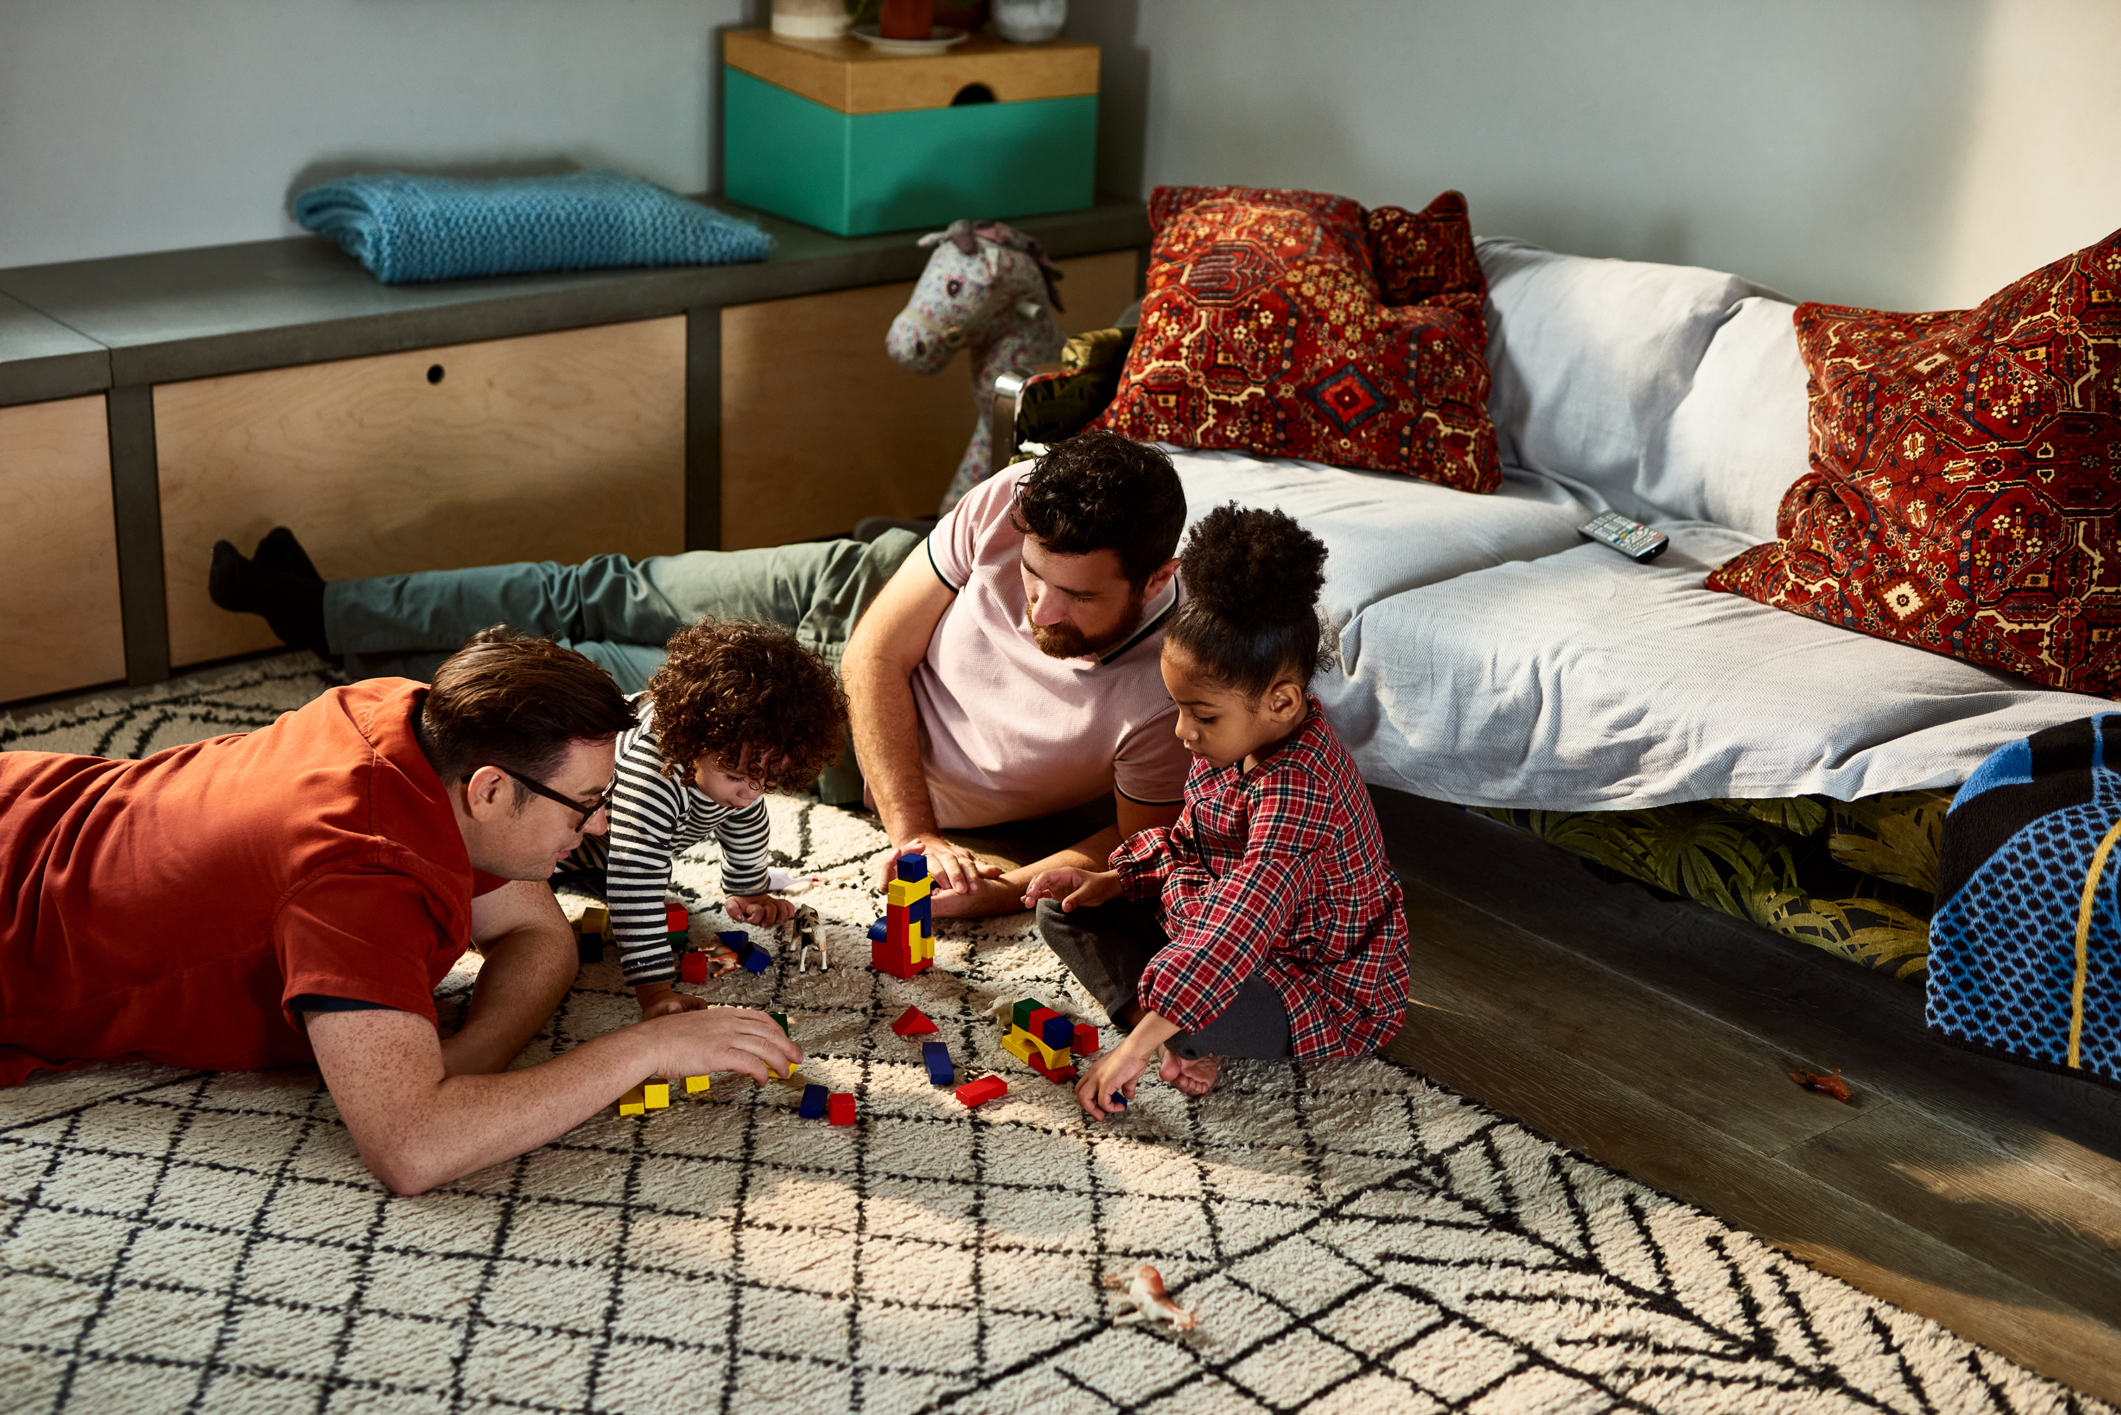
Loan Sharks
Notes:
The thing that makes a loan shark illegal is that they don’t have a licence to lend money! Borrowing money from a loan shark isn’t a crime! It’s the fact they are not authorised or regulated. Friend, elderly, young, single, couples, doctors, business men, pub landlord, nurses, tradesmen, criminal activity. Behaviour-identify weakness and exploit, payment in kind, friend or foe (have spoke to a CU who feels the LS is providing a service to the community)

Slide 5
A-Reporting to home office for deportation
B-Being chopped up and served as take away food
C- The cat would be killed by lender’s “cat killer dog”
D- Witchcraft
E-Your partner will find out
F-Sharing sexually explicit photos/videos
G- Shame on social media
H- Telling family “back home”

Slide 6
Impacts
Impacts are far reaching
Family and friends
Relationship breakdown
Work effected
Children and education
Mental and physical health
Community impacted
No control of own finances, leading to arrears on priority and even eviction

Slide 7
Access to credit
85% of all UK adults holds at least one credit or loan product
Access to credit is a large part of society
Credit score impacts far more than just the ability to access a loan

Slide 8
Why do people use a loan shark?
Recommended by someone they trust
Don’t realise the lender is a loan shark
Desperation as refused credit elsewhere
Preyed upon by a loan shark; easy option
Assumed they won’t get credit elsewhere
Notes:
Piggy back lending
Lots of reasons

Slide 9
Lending options
LOAN SHARK
No regulation – The loan shark calls the shots
Interest rates can be extortionate
Unaffordable repayments
Victim has no control over own finances
Bradford CU
Regulated and authorised by the FCA and PRA
Interest capped at
Bradford CU works with its members to ensure repayments are affordable
Members have full control over finances

Slide 10
What support we offer
Support for professionals in advice roles including training and materials.
Victim support – Local LIAISE officer allocated
24 hour helpline
Risk assessment
Needs assessment
Safe house
Live chat
Can access advice and support anonymously

Slide 11
We need your help
We are a very small team and far from a household name. The nature of this crime often means victims don’t even know they are victims or that support is available. Victims are likely to present with a range of symptoms caused by the loan shark before contacting us.
Access free training
If something doesn’t feel, sound or look right… ask
Report any information to us (GDPR exemption) can be anonymous
Request our posters, flyers, pens etc
Spread the word

Slide 12
Trish.Cassidy@birmingham.gov.uk
Any Questions?

