Slide 1
Talk Money Week 2024 Presentation

Slide 2
Session Outline
How BDCU used Community Development
to grow membership and lending.
History
Payroll Partners
Projects
Results

Slide 3
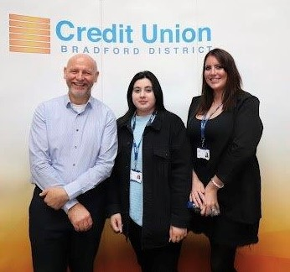
Meet The Team
Ian Brewer is EDI Community Development Lead with an international community development background. Ian leads on partnership community development projects to tackle poverty and manages employer engagement with its 34 payroll partner companies
Siobhan Graham is EDI Community Development Officer with a background in the NHS and runs the Community Development Projects as well works with Ian on payroll partnerships
Janka Brabcova is Marketing Apprentice working with the team to manage the website and creating marketing materials and just taken over from Fizza.

Slide 4
Bradford District Credit Union
History
1993 - Recession led to Bradford Council launching Industrial Credit Union
2005 - Extended to all residents of Bradford
2016 - Early adopter of online banking (app in 2018)
2016 - Council funded Financial Inclusion Officer
2019 - Extended to serve Kirklees & Craven (1.5 million people)
Membership Growth
1993 - 2016 = 3000 members
2016 - 2024 = 10,000 members
We help 3000+ financially excluded members
Provide ‘Faith Friendly’ ethical savings
How Much do 10,000 members Save?

Slide 5
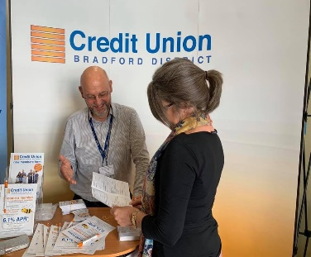
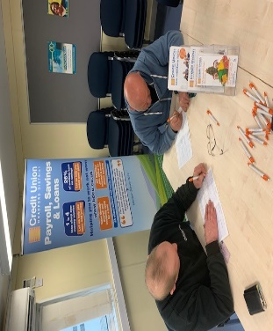
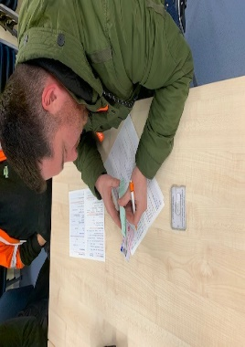
Workforce Payroll Savings
The Barriers
1 in 4 staff have major money worries
1 in 8 staff live in poverty unknown to employers
82% of workers have turned to high-cost credit
Alarming rise of Loan Shark use reported
Low credit score is a barrier to affordable loans
The Solutions
Financial Wellbeing improves performance
4,000 staff ‘Save & Borrow’ at 34 companies
Staff save £4.9 million and borrow £2 million
Loans build ‘Credit Scores’ alongside savings
Staff saving help us lend to financially excluded

Slide 6
Helping 4000+ Staff Save & Borrow
At 34 Company Saving Schemes

Slide 7
Our Community Partners
Community Development Projects
and Case Studies

Slide 8
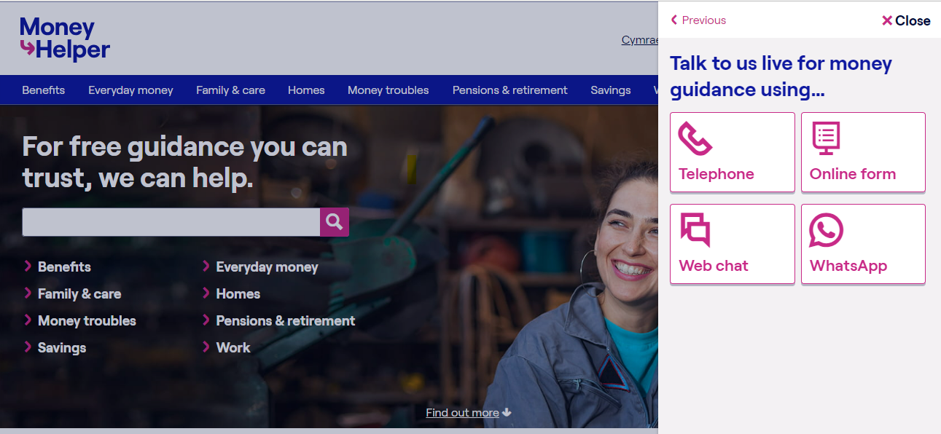
Key Partnerships
Notes:
BDCU is a preventative organisation
(Clockwise from Tackles Poverty):
1. **Tackles Poverty in Bradford, Kirklees, and Craven**
- Implements various projects aimed at supporting low-income families and reducing financial exclusion in these areas through targeted community initiatives and support services.
2. **Builds Community Resilience**
- Supports initiatives like FoodSavers and UniformSavers to tackle food insecurity and school uniform costs, promoting community resilience by ensuring basic needs are met.
3. **Promotes Savings Habits**
- Encourages regular savings through schemes such as Christmas Savers and Junior Savers, helping individuals and families build financial stability and plan for the future.
4. **Delivers Financial Education Webinars & Workshops**
- Offers comprehensive financial education through webinars and workshops, teaching financial management skills and raising awareness about the risks of high-cost lending.
5. **Offers Affordable Loans to Build Credit Score**
- Provides low-interest loans designed to help individuals avoid high-cost credit options and improve their credit scores, promoting long-term financial health.
6. **Payroll Savings and Loans for Staff**
- Enhances financial wellbeing for employees through payroll savings schemes and affordable loan options, making it easier for staff to save and borrow responsibly.
7. **Supports Mental Health**
- Partners with Mind in Bradford to integrate mental health support with financial wellbeing services, recognising the link between financial stress and mental health.
8. **Promotes Ethical Banking & ‘Faith Friendly’ Savings**
- Offers ethical banking options and faith-friendly savings products to meet the diverse needs of the community, ensuring inclusivity and ethical financial practices.
9. **Raises Gambling & Loan Sharks Awareness**
- Collaborates with NECA and Stop Loan Shark Team to educate and protect the community from the dangers of gambling and illegal lending, promoting safe financial practices.
10. **Leads Partnership Community Development Projects**
- Engages with local organisations to support community development initiatives and strengthen community ties, working together to build a more resilient and connected community.

Slide 9
Our Community Projects
Community Development Projects
and Case Studies

Slide 10
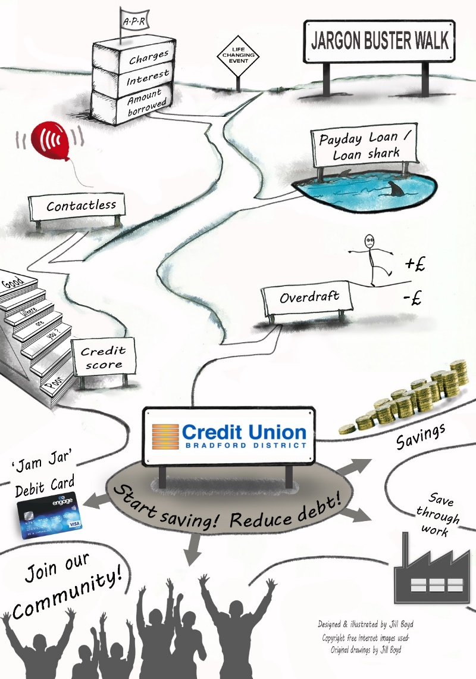
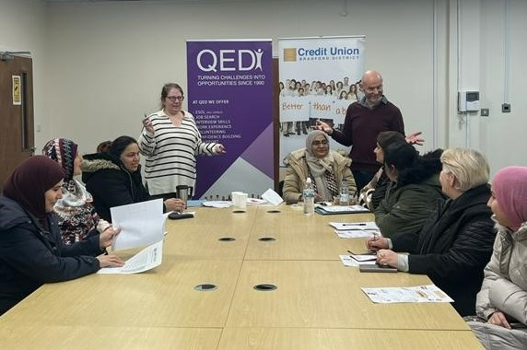
Financial Help and Workshops
‘Money SOS’ Workshop
What is APR?
PayDay and High Cost Lenders
Dangers of Loan Sharks
How Contactless Works
Overdrafts and direct debits
Improving your Credit Score
What the Credit Union offers

Slide 11
Learning from America
‘Making financial inclusion a priority at your Credit Union is not only a “feel-good” thing to do, it’s an effective business strategy, its in our DNA.’ (Scott Butterfield ‘Your Credit Union Partner’ USA)
Community Development is at the heart of serving low-income communities that have limited access to safe financial services (Inclusiv)
Visit to USA in 1999 and 2022 to share the Bradford Model.
Continued collaboration since.

Slide 12
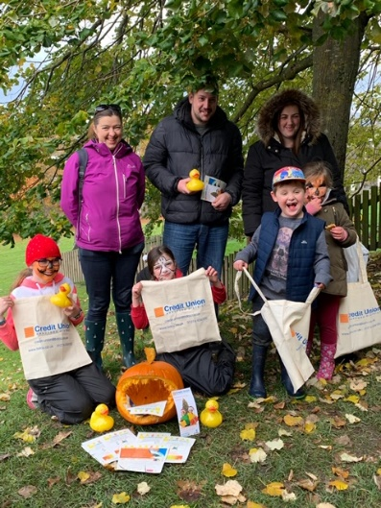
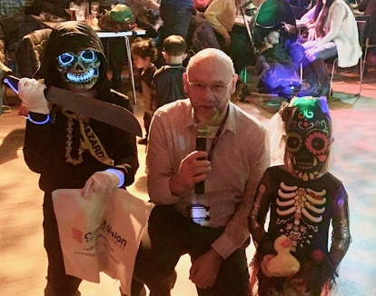
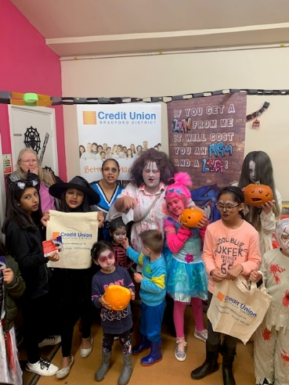
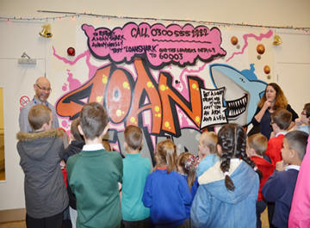
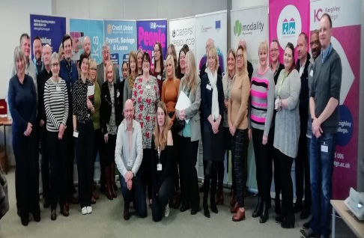
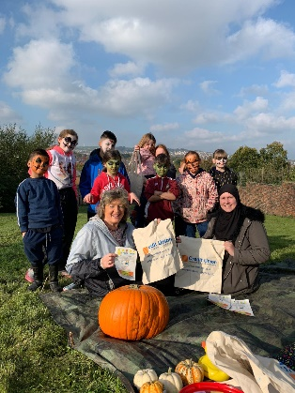
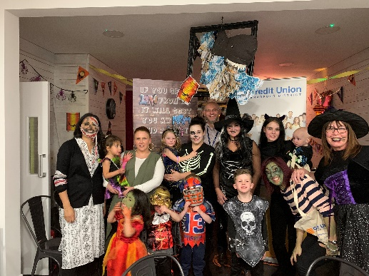
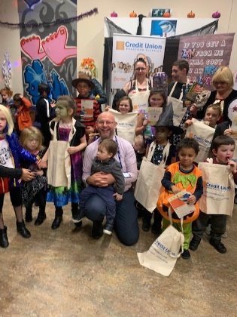
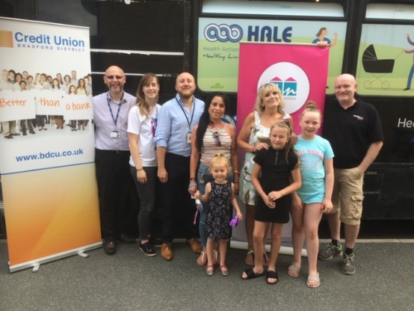
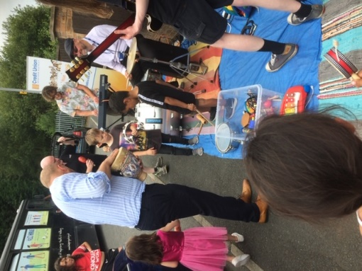
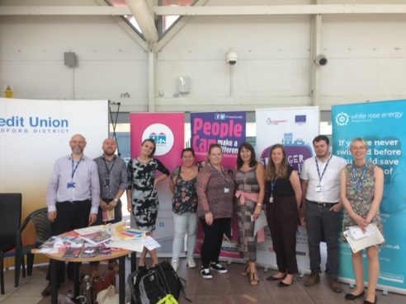
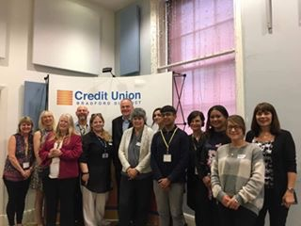
BDCU Led Partnership Projects
Conferences - Workshops - Road Shows

Slide 13
£120k Funding from WYCA and Bradford Council for two new projects:
£200 microloan scheme for people with poor credit score. Started as ‘Back to School Loan’ and now ‘Home Energy Bills Support Loan’
UniformSavers #3 to help more people save for school uniforms.

Slide 14
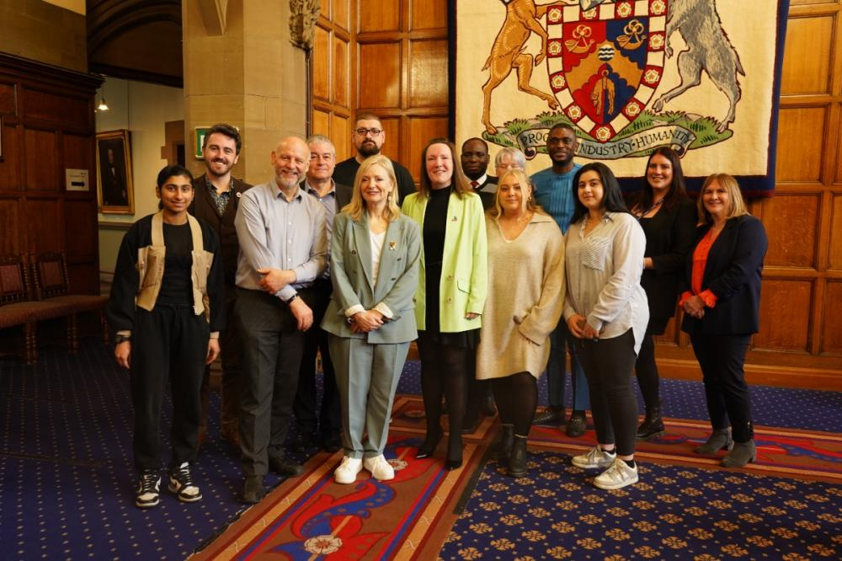
West Yorkshire Mayor’s Projects a huge success:
UniformSavers Key Statistics:
• 80% of participants saved, resulting in £28,841 total savings.
• 27 members took affordable loans totaling £12,825.
• 91% were female, with a high proportion employed in care and domestic work.
• The majority of participants were new to the Credit Union.
Microloan Key Statistics:
• 300 participants, with an average loan size of £200.
• 97% were employed and Acorn data shows these are low paid roles.
• 84% of participants were female, predominantly employed.
• 85% of those who repaid were approved for top-up loans, highlighting the success of the initiative in improving credit scores and reentering mainstream lending.
Projects covered in National Press and waiting on new funding rounds to apply again.

Slide 15
Health and Social Care Project
New project launch:
£51k VCS funding to help 600 staff in Health and Social Care and Bradford NHS Trusts to start saving with £30 incentive.
150 microloans of £200 underwritten for those with poor credit scores.

Slide 16
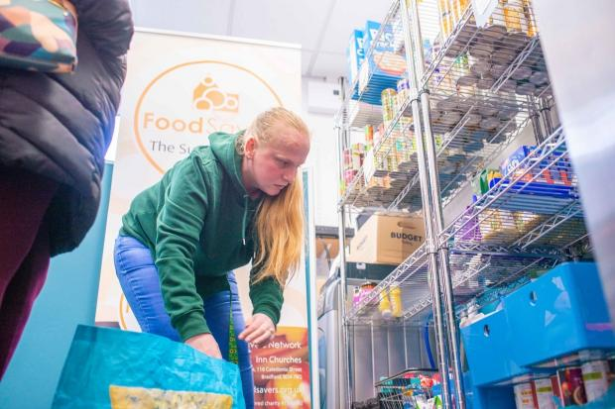
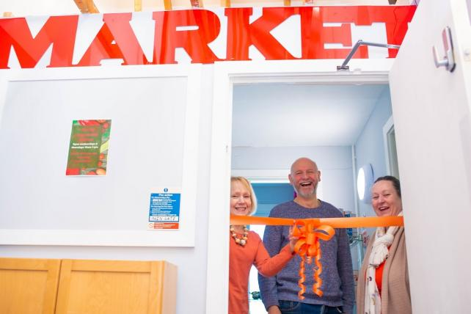
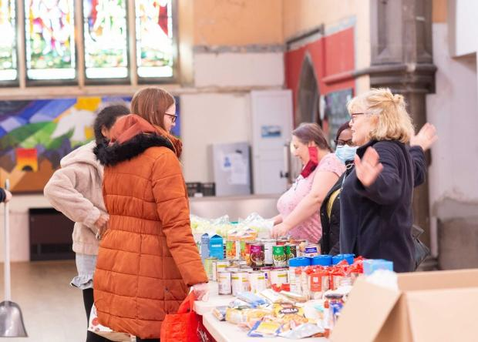
FoodSavers
Co-designed partnership project with Juli from Inn Churches to tackle food insecurity AND save into the credit union.
People pay £6 per bag of chosen food worth £30 and £1 goes into the BDCU.
‘Game Changer’ as many saved much more.
Results:
21 pantries
691 savers
Total Savings £52k!!!
West Yorkshire Roll Out

Slide 17
Results:
We are on target to grow by over 1000 people this year
UniformSavers, FoodSavers and Microloan added 600 new members
FoodSavers model is rolled out across West Yorkshire with Mayor Support
Reached 10k members in March 2024
Signed exclusivity deal with Bradford Council as sole Payroll Provider
Lending grown from 2.5 million to 3.7 million in last year
Competitive rates and social media campaigns increased from £15k-£25k
Acorn Demographic Mapping Analysis
The Acorn profile for Bradford Credit Union members is well below average when it comes to affluence – Credit Union target market
More than 57% members and 30% loans come from low income areas
Over 23% of members 30% of loans from “Cash-Strapped Families”
Payroll provides the higher value loans

Slide 18
Benefits of a Credit Union:
Start a savings habit from your wage without missing it
Internet and Smartphone Banking, Debit Card & Post Office
Same day withdrawals to your bank
Access to affordable loans paid back via payroll
All our loans build ‘Credit Scores’ alongside savings
Christmas Savers – Budget for Christmas
Junior Savers – Save for a child or grandchild
Faith Friendly – Halal dividend NOT interest on savings
Ethical banking that supports your community
‘Money SOS’ Workshops and MoneyTips on our website
Regular newsletter and staff loan offers for staff

Slide 19
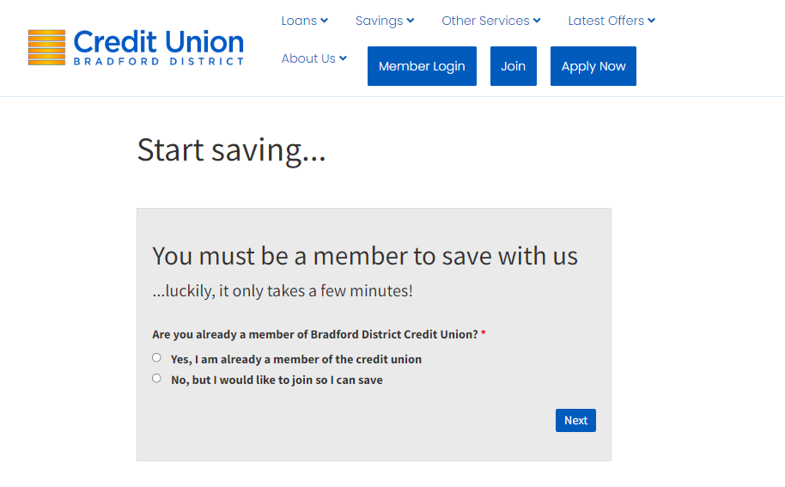
Join Today at www.bdcu.co.uk

Slide 20
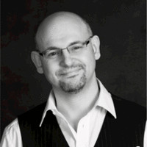
Contact:
Join at www.bdcu.co.uk
Ian Brewer ian.brewer@bdcu.co.uk
EDI Community Development Lead
City Hall Reception, Bradford, BD1 1HY
07533 547187

