Slide 1
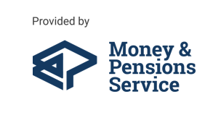

Welcome to MoneyHelper
Making your money and pension choices clearer.
Jenny Wright Regional Manager Yorkshire and Humber
moneyhelper.org.uk
#TalkMoney
Notes:
MoneyHelper is here to help, so you can move on with life.
Here to cut through the jargon and complexity, explain what you need to do and how you can do it. Here to put you in control, with free, impartial help that’s quick to find, easy to use and backed by government.
Whatever your circumstances or plans, MoneyHelper is on your side. Online and over the phone, you’ll get clear money and pension guidance. We can also point you to trusted services, if you need more support.
Open to everyone, MoneyHelper is helping people to clear their debts, reduce spending and make the most of their income. To support loved ones, plan ahead for major purchases and find out about entitlements. To build up savings and pensions, and know their options.
For money help all in one place that’s free to use, just search for MoneyHelper.

Slide 2


Slide 3

Talk Money
With the current cost of living pressures, it’s more important than ever that we get support for money worries.
Research shows that people who talk about money:
Make better and less risky financial decisions
Have stronger personal relationships
Help their children form good lifetime money habits
Feel less stressed or anxious and more in control.
Building money conversations into our everyday lives also helps us build financial confidence and resilience to face whatever the future throws at us.
#DoOneThing #TalkMoney

Slide 4
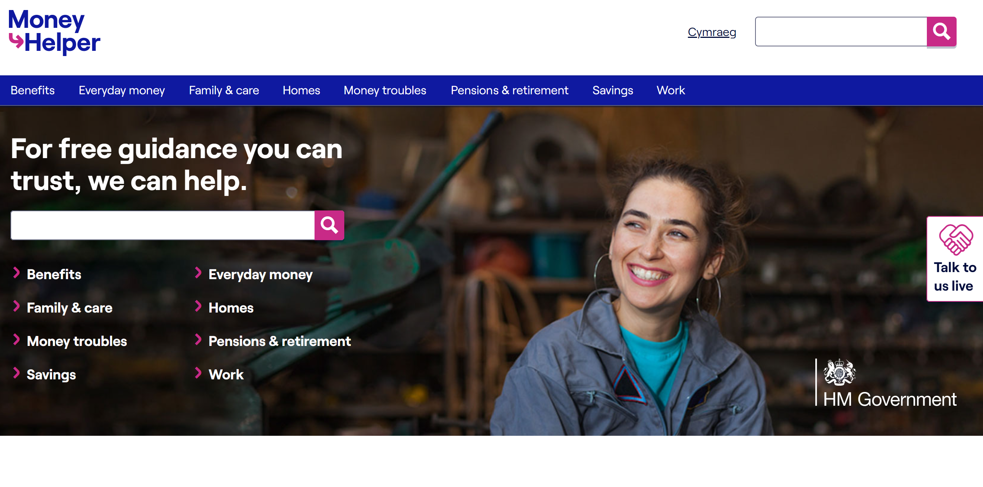
What we cover
https://www.moneyhelper.org.uk/en

Slide 5

Your pension journey
It’s never too early (or late) to start planning……

Slide 6
How much money will you need?
The answer to this question differs for everyone and will depend on your circumstances.
Research originally published in 2018 (and based on prices updated in 2024) sets out three suggested levels of expenditure in retirement:
 | Single person | Couple
Minimum – covers basic needs, maybe some left over for ‘fun’ | £14,400 £15,700 (London) | £22,400 £24,500 (London)
Moderate – allows for financial security and flexibility | £31,300 £32,800 (London) | £43,100 £44,900 (London)
Comfortable – more financial freedom and luxuries | £43,100 £45,000 (London) | £59,000 £61,200 (London)
Read more here: retirementlivingstandards.org.uk/
See what you’re on track to get from just your pensions using our budget worksheet and calculator:
moneyhelper.org.uk/en/pensions-and-retirement/building-your-retirement-pot/check-the-progress-of-your-pension-and-retirement-savings

Slide 7
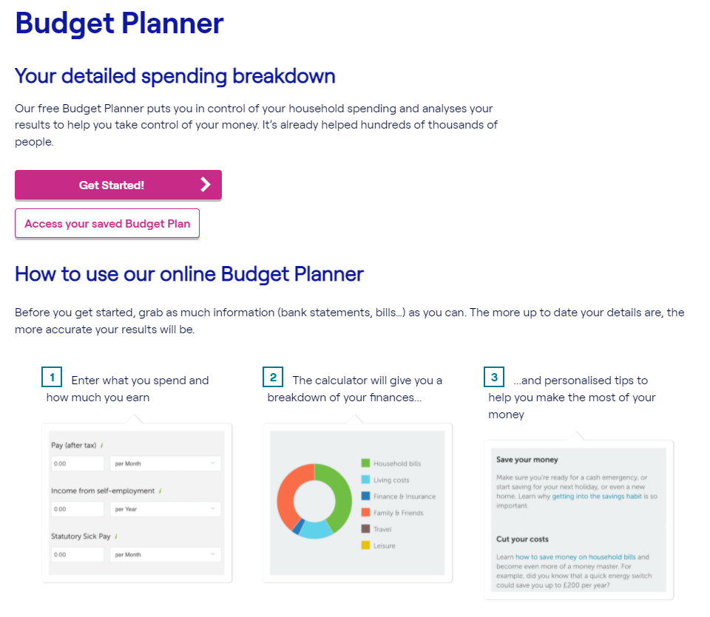
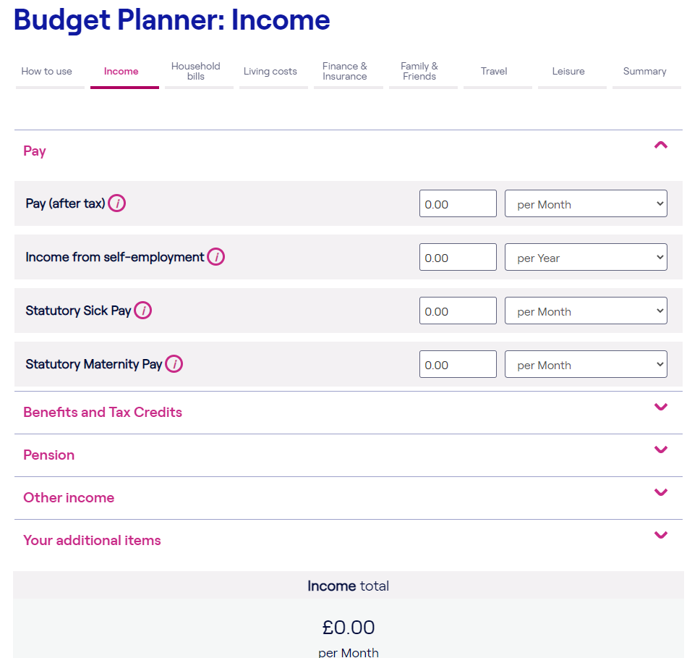
Notes:
Mention that we have other tools and information on the MoneyHelper website – for example which bills you should prioritise if you are struggling, and information on saving money and bank accounts.
Link is to the pdf planner sheet

Slide 8
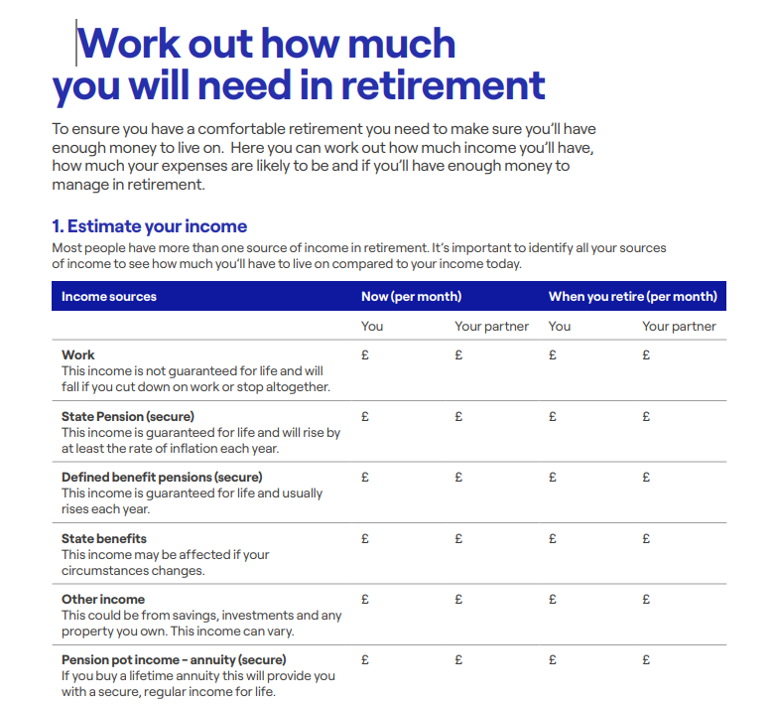
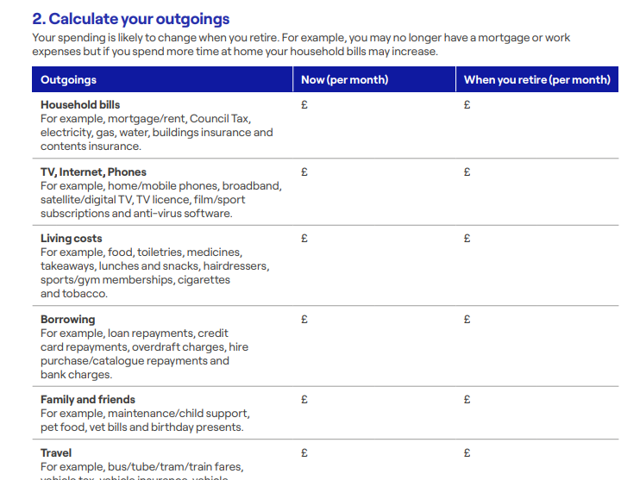
Budgeting in retirement worksheet
https://www.moneyhelper.org.uk/en/pensions-and-retirement/building-your-retirement-pot/check-the-progress-of-your-pension-and-retirement-savings#check-your-progress-using-our-retirement-planning-worksheet

Slide 9
State Pension
Paid in addition to your workplace pension
The full new State Pension from April 2024 £221.20 a week (£11,502 a year)
You’ll need at least 35 qualifying years of National Insurance contributions to receive the full new State Pension but 10 years to get some State Pension.
You can find out your own State Pension age here: gov.uk/state-pension-age
For example, someone currently in their thirties can’t claim their State Pension until age 68
You can request a State Pension forecast online to see your current position: gov.uk/check-state-pension
(a Government Gateway or GOV.UK Verify account is required)
If there are any gaps in your National Insurance record, you may be able to pay voluntary National Insurance contributions to top up your State Pension.
Visit gov.uk/voluntary-national-insurance-contributions for more information or call the Future Pension Centre on 0800 731 0175.
Notes:
Explain qualifying year

Slide 10
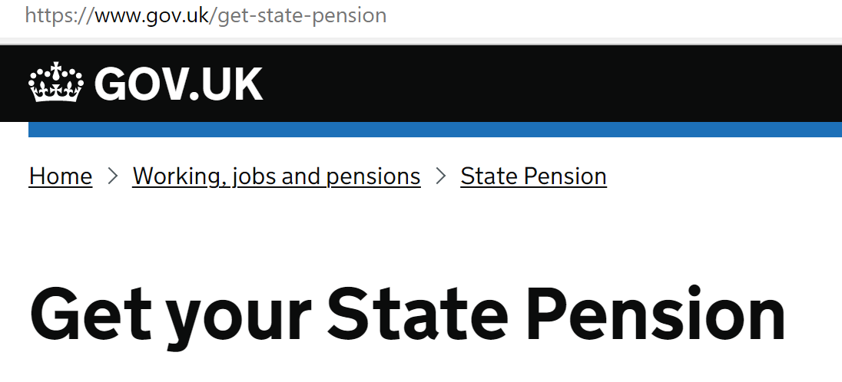

The New State Pension – claiming and payment
You need to claim
Payment isn’t made automatically – it needs to be claimed
The Pension Service (DWP) will contact you 2 – 4 months before State Pension Age
Can claim quickly online, or ask for paper form
Call 0800 731 7898 for new claims
Payment
State Pension is paid 4 weekly in arrears - first payment within 3-5 weeks of State Pension Age
Taxable and NOT means tested
The payment day will be decided by the last two digits of your National Insurance number
Not usually inherited by a spouse/civil partner and never inherited by anyone else

Slide 11
What type of pensions are there?
Defined Benefit (DB) - now mainly public sector
Gives you a guaranteed income for life.
Defined Contribution (DC) - most current schemes
A pot of money that is built up and invested.
Pays a regular pension income usually with the option of a tax-free lump sum and a reduced income.
Can normally be accessed after reaching age 55*, but the pension is likely to be reduced for early payment.
Find out more on defined benefit pensions here.
Up to 25% of the pension pot can usually be paid as a tax-free lump sum.
There are a flexible range of options for drawing money out of the pot after reaching age 55*.
Find out more on defined contribution pensions here.
* Normal Minimum Pension Age (NMPA) will increase to age 57 from 6 April 2028 but some individuals will still be able to keep a NMPA of age 55
Notes:
Mix of RBP (a CARE scheme), USS, some NHS, NEST

Slide 12
Why are private/workplace pensions a good way to save?
The State Pension alone (£11,502 a year) is unlikely to be enough for many people.
A private pension can normally be accessed much earlier than your State Pension.
You receive tax relief on the money you pay into a pension, so some of the money that would’ve gone to the government as tax goes into your pension instead.
‘Free money’ from your employer who pays into the scheme too
You can often take up to 25% of the value of your pension benefits as a tax-free lump sum.

Slide 13
Paying into a workplace DC pension vs non-pension savings
Other savings
Pension savings
Gross salary per month
£2,000
Employee pension contribution
£80
+
Tax relief
£20
Employer’s pension contribution
£60
Your contribution
Total contribution £40
Tax relief
Employer’s contribution
Your
contribution
Total contribution = £160
Total contribution = £80
Example with 3% employer contribution plus 5% employee contribution
Notes:
Emphasize this applies to DC schemes

Slide 14

Why is it important to look after your pension?
  Did you know?
  The State Pension alone is unlikely to be enough for many people. Currently £11,502 per year
  A private/workplace pension can generally be accessed much earlier than your State Pension.
  You receive tax relief on the money you pay into a pension, so some of the money that would have gone to the government as tax, goes into your pension instead.
  You can often take up to 25% of your pension pot as a tax-free lump sum.
  You benefit from ‘free money’ from your employer who also pays into your workplace pension.
  Pensions can also help with inheritance tax planning because death benefits
  paid from a pension scheme are often not counted as part of your Estate.

Slide 15
What happens to a pension on death?
State Pension
  State Pension is an individual entitlement and isn’t normally inherited by a spouse/civil partner
  In some cases, a top up of pension may be payable – usually people who reach State Pension Age before 6 April 2016 and have only a small pension themselves - is automatically paid as part of own pension
  Defined Benefit
  Death benefits depend upon the individual rules of the scheme – check with the scheme
  Typically includes a pension payable to a spouse or partner at a reduced rate
  Dependant’s pension usually only payable to a child if under 23 and in full time education
  May be a lump sum payable to a nominated beneficiary if died before or within 5 years or retirement
  Defined Contribution
  Full value of pension pot can usually be paid tax free to beneficiary(ies) on death before age 75
  On death after age 75, beneficiaries will pay income tax on any money received
  Payments to beneficiaries are usually free of Inheritance Tax*
  If an annuity has been purchased, death benefits were chosen at retirement
  A Nomination Form tells the scheme who you’d like to receive any benefits payable on your death

Slide 16
Tracing old pensions
You don’t have to click on any adverts for tracing help or pay anyone to trace your pensions
  Pensions Dashboard launch TBC – listing all scheme
  benefits for an individual
  Currently no central database but you can find contact details for old pensions via the Pension Tracing Service: gov.uk/find-pension-contact-details
  You can leave old pensions where they are or transfer to a different pension scheme – you may want to combine pensions – easier with DC pensions.
  It’s only from 2012 onwards that employers were included in automatic enrolment – before this there may have not been a scheme
More information from MoneyHelper about tracing your pensions and pension transfers:
moneyhelper.org.uk/en/pensions-and-retirement/pension-problems/tracing-and-finding-lost-pensions
moneyhelper.org.uk/en/pensions-and-retirement/building-your-retirement-pot/uk-pension-transfers
Notes:
If a member has pension rights in a scheme, the pension provider will keep those details on file indefinitely. However, if someone has not joined the scheme, or if they left and received a refund of their contributions, or transferred their benefits out of the scheme, then that person's details will not remain in their records in the years to come

Slide 17

Women and pensions
Women typically have about half the pension pot that a man has at retirement
This is due to:
Gender pay gap (25% in women over 50)
Career breaks (no pension paid during unpaid maternity leave)
Part time work (75% of part time workers are women)
Work changes due to menopause
Women over 50 are twice as likely to provide unpaid care for others than men
Divorce increases the savings gap with women being more likely to waive rights to a partner’s pension and only 3% of people seeking financial advice as part of their divorce

Slide 18


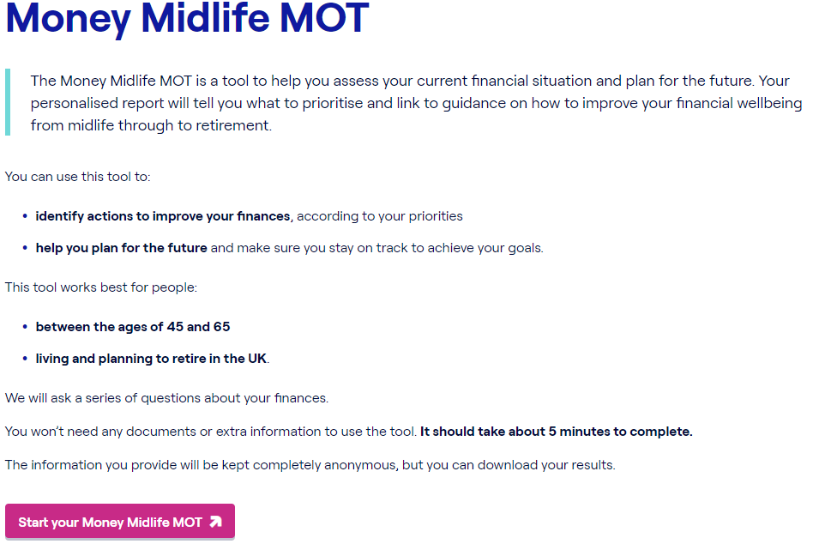
    Mid Life MOT
Pensions Guidance
https://www.moneyhelper.org.uk/en/everyday-money/midlife-mot
Notes:
The Midlife MOT is a tool to help people assess their current financial situation and plan for the future. It asks a series of questions about their finances, covering: debt; budgeting; emergency and non-emergency savings; insurance, and pensions.
It produces a personalised report, which will help them identify what to prioritise and link to guidance on how to improve their financial wellbeing from midlife through to retirement and later life.
This tool can be used to:
identify actions to improve their finances, according to your priorities
help them plan for the future and make sure they stay on track to achieve their goals
This tool works best for people:
between the ages of 45 and 65
living and planning to retire in the UK
They won't need any documents or extra information to use the tool. It will take about 5 minutes to complete.
The information they provide will be kept completely anonymous, but they can download their results.

Slide 19

Where to save more
Pay more into your workplace pension
Ask your payroll team for more information
Pay into a different pension
E.g. personal pensionmoneyhelper.org.uk/en/pensions-and-retirement/pensions-basics/choosing-a-pension-yourself
Other Assets
E.g. savings products, investments, property moneyhelper.org.uk/en/savings/types-of-savings

Slide 20


Slide 21
What can you do now?
Trace lost pensions
Trace any lost pensions using the Government’s tracing service: gov.uk/find-pension-contact-details
State Pension
Get a State Pension forecast: gov.uk/check-state-pension
Nominate beneficiaries
Make sure your death benefit nominations are up-to-date for your current and any previous pensions
Calculate
Use our pension calculator to see what you’re on track to get when you retire and consider whether you want to pay more into your pension to increase your benefits
Budget
Use our helpful budget planner to keep track of your spending now and in retirement
Mid Life MOT
https://www.moneyhelper.org.uk/en/everyday-money/midlife-mot
Get a personalised report to prioritise your next steps

Slide 22


Speak to us:
Looking for pension guidance?
Phone: 0800 011 3797
Webchat: moneyhelper.org.uk/pensionschat
Or, if you’re over 50 with a defined contribution pension, use our Pension Wise service to discuss your options:
Phone: 0800 138 3944
Online: moneyhelper.org.uk/pensionwise
Looking for money guidance?
Phone: 0800 138 7777
Webchat: moneyhelper.org.uk/moneychat

