Slide 2
Bradford District and Craven Mind
We are an independent, local mental health charity affiliated with National Mind.
We are part of a network of over 100 local Minds.
Our mission is make sure no one in the Bradford District or Craven has to face a mental health issue alone. ​

Slide 3
From 1 Sept 2024
We are Mind in Bradford.
We are Bradford District and Craven Mind.
Notes:
SB: Why the name change
We have been operating for 30 years under a Bradford centric name.
Last year we supported over 17,000 people with the mental health, a significant proportion of whom came from Bradford District and Craven - these are your friends, families and employees.
We've changed our name to better reflect the region we support.
We are also hoping to make it more obvious to the businesses across Bradford District and Craven that we are here for your people – and in return you may feel it is appropriate to support us on our vision to ensure no-one in BD&C has to face a mental health issue alone.

Slide 4
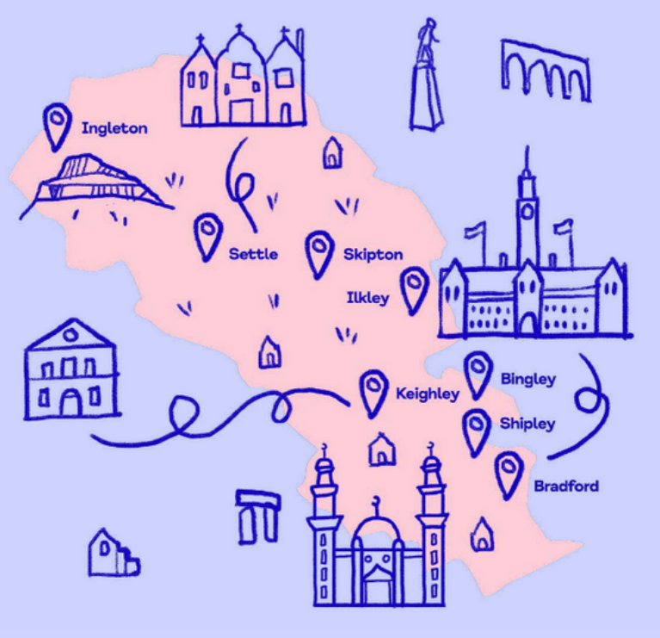
We are Bradford District and Craven Mind
“We believe this name will allow people from communities outside of Bradford to know we are here for them and they can access our services.”
Helen Davey, CEO
Notes:
SB

Slide 5
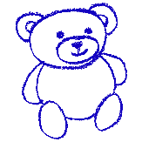
Impact Report 2023-2024
In the last year, we supported over 17,000 individuals across over 53,000 interventions including:
2,782 children and young people, aged 5 to 25, supported by the Youth in Mind partnership
11,352 live calls and chats to Guide-Line
10,332 crisis and support sessions provided by Safe Spaces and Hospital Buddies

Slide 6
Support for you
Guide-Line:
Guide-Line provides confidential, emotional support to you every day and night from 8am to midnight.
Call us for telephone support on 08001 884 884 or chat to us online.
Safe Spaces:
Anyone aged 7 or over living in Bradford District and Craven can access urgent same-day support from Safe Spaces at our Bradford and Keighley Hubs.
Call First Response on 08009 521 181 and ask for ‘Safe Spaces’ crisis support or call Guide-Line.

Slide 7
Support for you
Know Your Mind:
Young people in Bradford District and Craven struggling with their mental health. This service is for those aged between 8-19 or up to 25 with additional needs.
You can refer yourself or someone else using our online referral form.
Other services:
Wellbeing groups
Hearing Voices group
Enhanced Access (GP support)
Befriending service
Healthy Minds
Visit our website to find out more about all of our services:
mindinbradford.org.uk/support-for-you/

Slide 8
Get involved!
Volunteer
We have lots of events where you can help us fundraise or services you can work on in your spare time to build up your CV.
Fundraise
Why not take on a fundraising challenge. We have a full calendar of events on the website, or do your own thing!
Work for us
We have over 100 staff working full-time and part-time at Bradford District and Craven Mind.

Slide 9
Bradford District and Craven Mind
Kenburgh House
28 Manor Row
Bradford
BD1 4QU
T: 01274 730815
www.mindinbradford.org.uk
admin@mindinbradford.org.uk
Registered charity number 1142357

