Slide 1
Yorkshire and Humber
Support for those impacted by gambling related harms

Slide 2
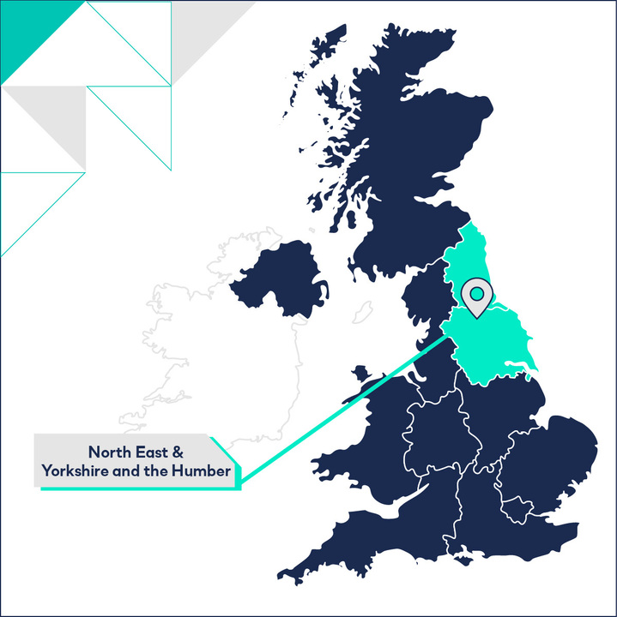
Gambling Statistics
60% of adults living in Great Britain reported participating in a gambling activity in 2022
The Yorkshire/Humber region has a higher gambling prevalence than the national average, ranking as the region with the fourth highest rate of gambling, with just over 60% of respondents (61.3%) engaged in any form of gambling in 2021. This is equivalent to 2,744,000 adults in the region.
Notes:
PGSI – Problem Gambling Severity Index The pie chart shows the number of completed treatment cases from 1st April 22 – 31st March 23 who completed with a PGSI score of 0-8, it shows the numbers who completed their treatment with a pgsi score of 0, then completed with score of 1-7 and the small majority who completed with a PGSI score equal to 8. N=121 is the number of clients.

Slide 3
Gambling related-harms
Gambling-related harms impact on people’s resources, relationships and health.
Negative effects can include loss of employment, debt, crime, breakdown of relationships and deterioration of physical and mental health.
The harm caused can be devastating and lead to people to taking their lives.
Harms can be experienced not just by gamblers themselves. They can also affect their children, partners, wider families and social networks, employers, communities and society as a whole.

Slide 4
Our Services
NECA are passionate about the wellbeing of all within our communities.
Alongside the delivery of support, we provide information on prevention and increase awareness around gambling harms.
We provide free awareness and gambling related harms champions sessions.
We work with a range of providers across all sectors to embed:
Key questions into their communications or initial assessment.
Clear referral pathways into Support and Treatment.

Slide 5
We offer support to anyone age 18 and over who is experiencing gambling related harms, including family members, partners and friends. We offer 1 to 1 and group support.
Individuals and professionals can refer through our website, calling or emailing us or via a QR code.
We can also refer to other gambling support services if they are more able to meet the individuals’ needs.

Slide 6
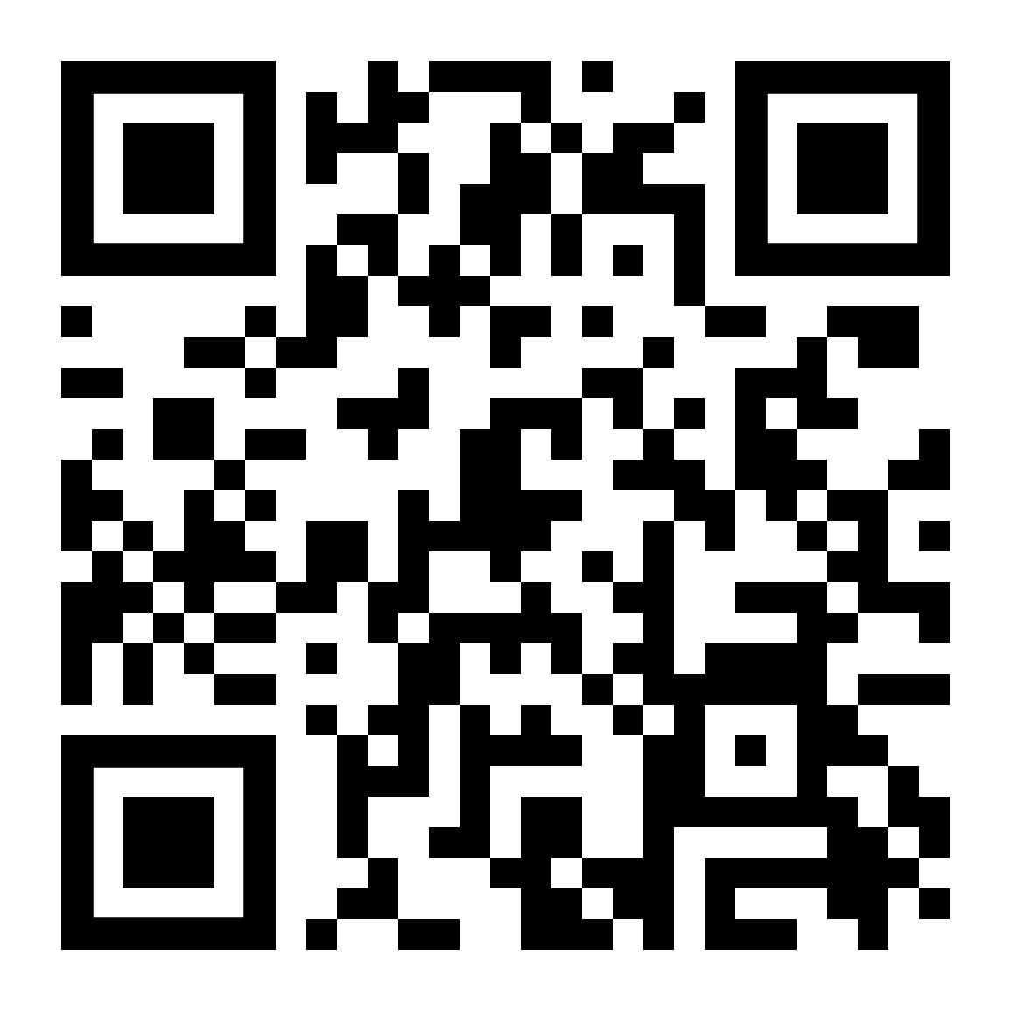
How to access support:
Self Referrals Telephone: 01423 740723 NECA Website/QR code | Professional Referrals Telephone: 01423 740723 NECA Website/QR code Referral form via CJSM | Helpline Referrals 24 hours 0808 8020 133

Slide 7
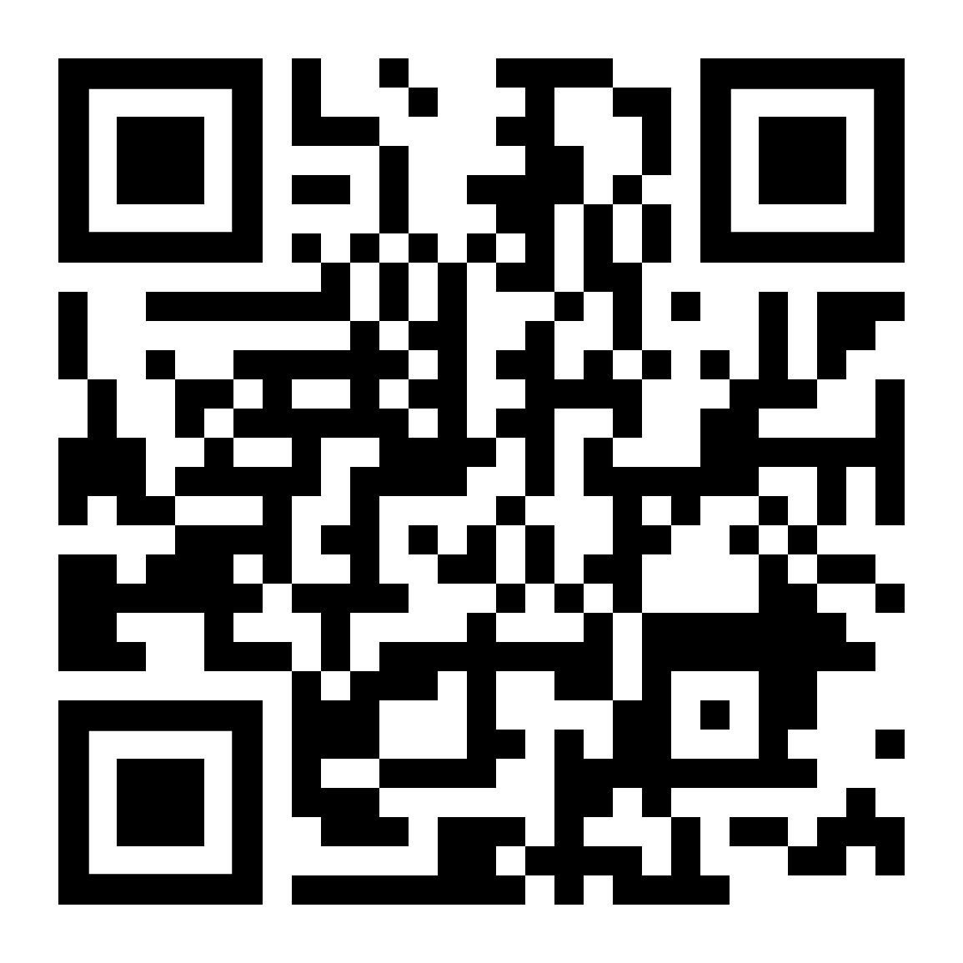
Referral
Treatment
Review
Referral into NECA via;
External (i.e. GP)
Self-Referral
National Gambling Helpline
Triage/Assessment
Client to be contacted within 24-48 hours to complete initial assessment.
Appointment offered, usually within 1 week of referral. This can be face to face, telephone or virtual.
Clients offered ongoing appointments with regular reviews.
Once discharged clients will receive 3, 6 and 12 month follow ups, with the option to contact NECA / their practitioner for further support at any time.
A variety of treatment options are available including ; PSI intervention, Support Groups, Signposting, Extended BI, Care coordination, Relapse prevention.
Referrals to external services/partnerships may be made, with consent, according to client need.
The Client Journey
01423 740 723 (Yorkshire & Humber)
Visit www.neca.co.uk
To complete a referral scan the QR code
In partnership with
Notes:
One to One therapeutic support for people with gambling problems and affected others.
Peer support groups for individuals in recovery from problem gambling and affected others
RELAPSE PREVENTION Programme which provides strategies to support and enable individuals to anticipate and cope with the potential for relapse.
BRIEF INTERVENTION Awareness and strategies around the physical and psychological impact of gambling.
SIGN POSTING Signposting onto relevant other organisations for further support outside of the remit of direct gambling support. E.g housing support, debt management
SELF-HELP RESOURCES Helpful and interactive resources to assist anyone who has recognised that gambling may is an issue in their life . E.g., blocking software, self-help workbooks.
Tier 4 referral for rehad – Gordon Moody and Adreriad for dual diagnosis eg drugs/alcohol and the Hurley Group

Slide 8
Self-exclusion
Gamstop - Free online self-exclusion scheme www.gamstop.co.uk
Gamban - Blocking software which can be installed on multiple devices www.gamban.com
Bank gambling transaction blocks- free tools offered by most UK banks

Slide 9
Exclusion from land-based venues
MOSES- Self exclusion from betting shops http://self-exclusion.co.uk/
- 0800294 2060
Sense - Self exclusion from casinos www.sensescheme.com
BISES (Bingo Industry Self Exclusion Scheme)
www.bingo-association.co.uk/self-exclusion
Bacta- self-exclusion from arcades
https://bacta.or.uk/self-exclusion/

Slide 10
NECA Champions Charter
NECA will provide you and your organisation with tools to identify gambling related harms, and any potential triggers alongside clear referral pathways into our services. We would value working in partnership with you and your organisation.
What will it mean for me?
As a Gambling Champion, you will be the point of contact within your
organisation. If people need; Leaflets/resources or awareness of support and pathways into services.
Our commitment to you -
We will supply resources and support to ensure this will have minimal impact on your current role. We will also provide gambling related harms awareness sessions to add to your portfolio of skills.

Slide 11
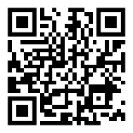
Has your gambling or the gambling of someone close to you, had a negative effect on your life?
mandy.brown@neca.org.uk

Slide 12
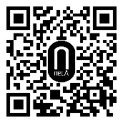
Telephone NECA
on 01423 740723
Referral via
our website: www.neca.co.uk

