Slide 1
Danielle King Prevent Coordinator Bradford Council
Spotting the signs of fake news

Slide 2
Fake News
False or misleading information presented as news.
Misinformation is untrue information created and shared as if it were true, there is no intention to cause harm but it can. This is generally rumour and gossip, someone sharing unverified stories, information or images without understanding that they are either misleading or untrue
Disinformation is untrue information that is created and shared in order to deceive and/or harm a person, organisation or social group. It is created by groups, countries, people with their own agenda, to further their own aims. This is when someone uses misleading stories, information or images on purpose, fully aware that the information is false or has been maliciously manipulated.

Slide 3
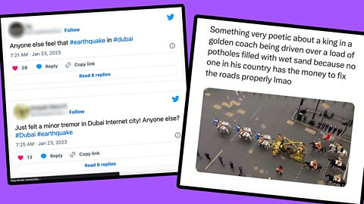

Slide 4
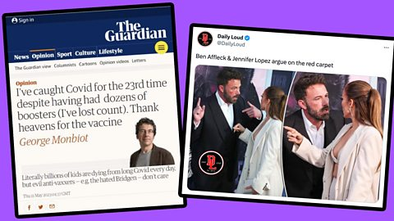

Slide 5
Fake news can also lead to Conspiracy Theories
Conspiracy theories work best when we:
are coping with a threat
feel powerless
can’t explain what’s happening
don’t like what we are being told to do.
The conspiracy theory will tell us:
we need to blame somebody
people more powerful than us are out to ‘get us’
there’s a secret explanation
not to do what the politicians / leaders are telling us to do
A conspiracy theory is defined by four characteristics:
a group -
acting in secret
to alter institutions, usurp power, hide truth, or gain utility,
at the expense of the common good.
Notes:
Conspiracy Theories can literally be harmful to our health – we don’t need to observe social distancing, vaccines are a trick to control us or infect us.
Conspiracy Theories are harmful to the environment – there is no such thing as global warming, global warming is a lie to damage big western economies.
Conspiracy thories are

Slide 6
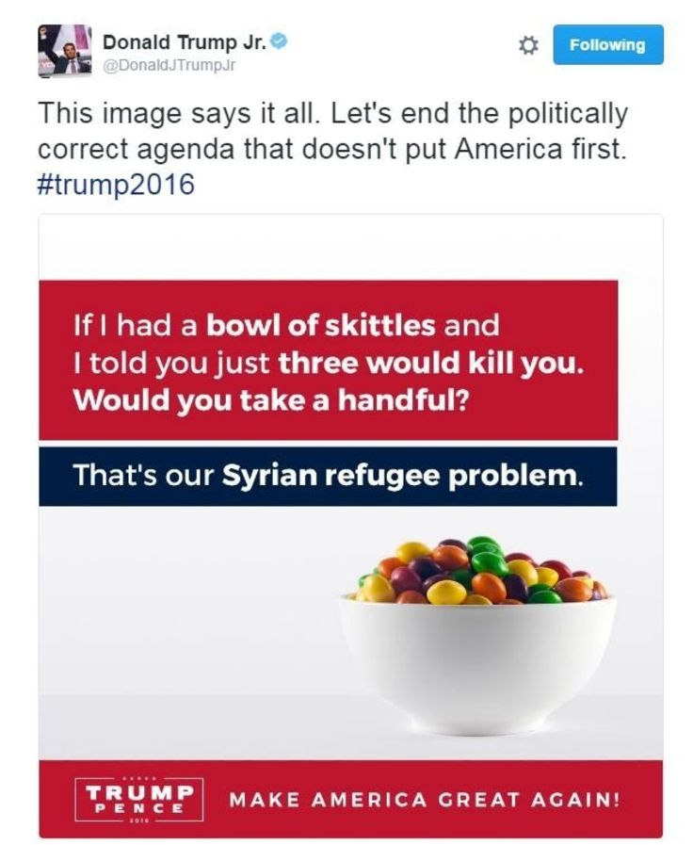
Don’t Be Fooled Online
The online world can be both a great source and a questionable source of information. Having identified some of the less reliable elements of the online space, take a look at the following tips to help you question the information you access digitally.
WHAT IS YOUR FIRST REACTION?
Are you angry, outraged, curious, excited?
Misinformation often tries to hijack our rational minds with strong emotional pulls.
In 2016, Donald Trump's eldest son caused uproar on social media by comparing Syrian refugees to the fruit-flavoured sweets Skittles.

Slide 7
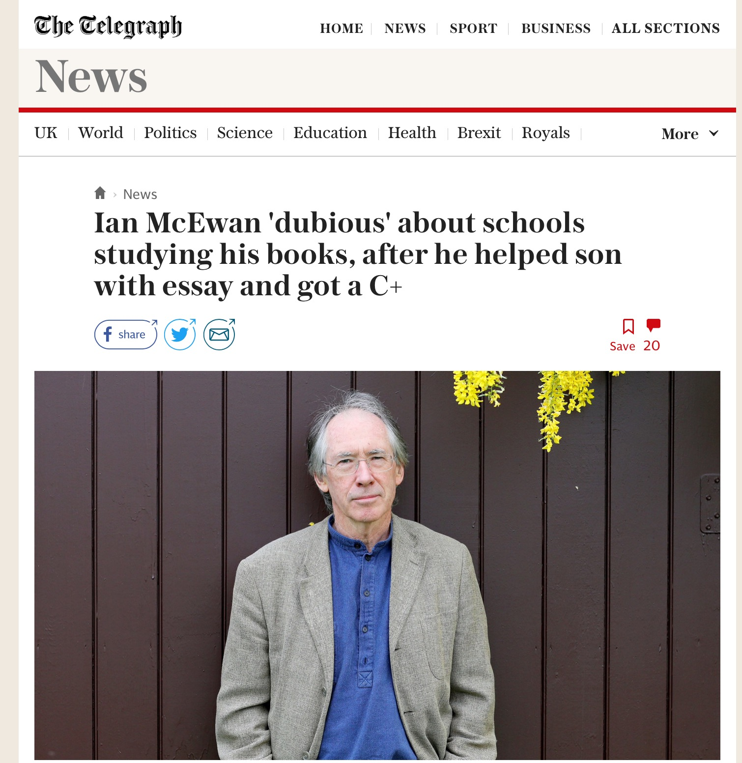
Don’t Be Fooled Online
2. WHAT IS THE PURPOSE OF WHAT YOU ARE READING, WATCHING OR HEARING?
Is it a news report, opinion column, advert, satire etc?
What do you know about the source (news outlet, blog, meme generator)?

Slide 8
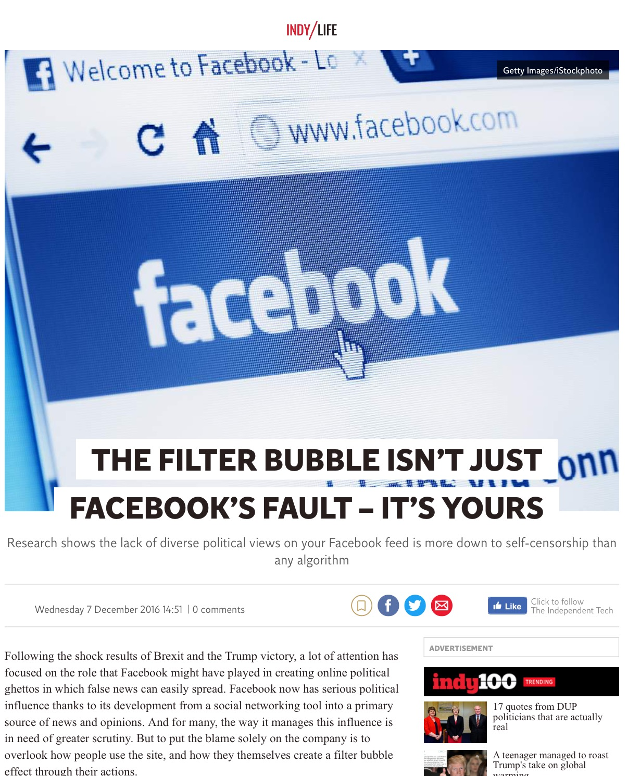
Don’t Be Fooled Online
3. BE AWARE OF YOUR OWN BIASES.
Are your reactions a result of personal viewpoint or opinion?
Try looking at a range of sources to consider other viewpoints.

Slide 9
Don’t Be Fooled Online
4. CONSIDER THE MESSAGE
Is it too perfect?
Is it overtly or aggressively partisan?
Does it use loaded language, excessive punctuation (!!!) or ALL CAPS for emphasis?
Does it claim to contain a secret or tell you something that the media are covering or lying about?
An example of extremist propaganda using loaded language and assertion with no evidence

Slide 10
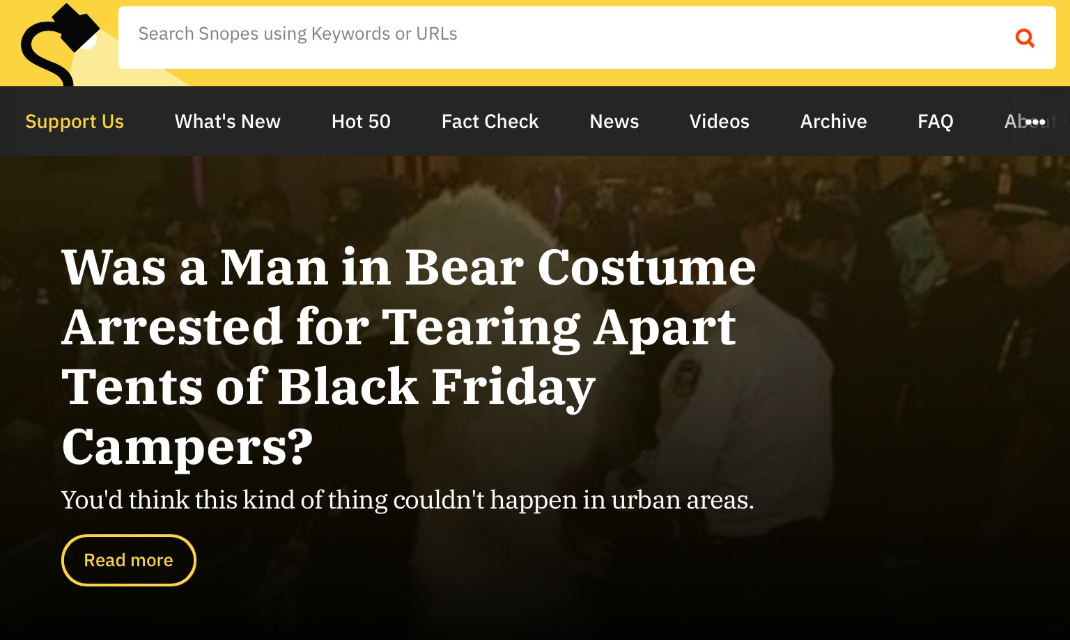
Don’t Be Fooled Online
5. SEARCH FOR MORE INFORMATION
Are reputable news outlets reporting the same thing?
Have you checked independent fact-checkers?
Where and when did the information originally appear?
What is the web domain?
Can you do an image search?
Snopes, Full Fact, BBC News Fact Check, and Channel 4 News Fact Check are useful!
Google can find the first time an image was put in the internet. You can then see if it’s been altered!

Slide 11
How might they be influencing you ?
ASSERTION
Saying something like it’s a fact, but really it’s just a statement that may or may not be true.
BANDWAGON
Being influenced to follow the crowd in order to fit in, because everyone else is doing it.
OMISSION
Missing out small facts which radically change the meaning of the message.
LESSER OF TWO EVILS
Convincing you to make a bad choice by comparing it to something worse when there could be another option.
SCAPEGOATING
Blaming a problem on one person/a group of people, even though there could be other factors involved.
TRANSFER
Transferring what you think or feel about one thing onto another thing, for either good or bad reasons.
AMBIGUOUS WORDS
Using words or phrases which can be interpreted in many different ways to fit a particular context or agenda.
GENERALISATION
Making a judgement on something without being able to fully prove it.
Notes:
Online Propaganda- Techniques
Whilst individuals may post explicit hate speech online, there are also groups who wish to promote violent or hateful agendas and ideas through the use of propaganda. Here are some of the techniques commonly seen in propaganda from sources ranging from adverts to extremist groups online.

Slide 12
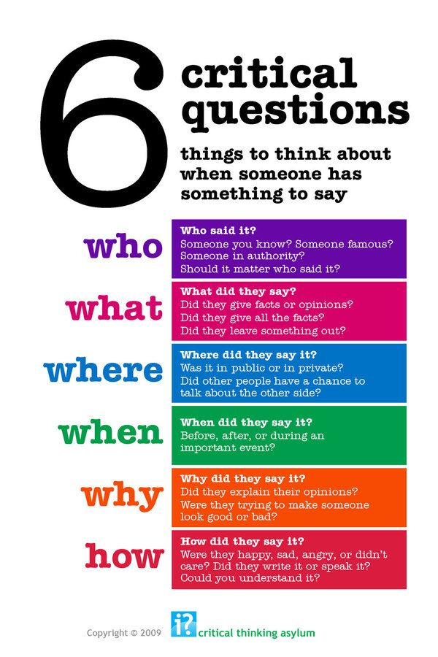

Slide 13
You do not have to react immediately or rush to respond. You have the freedom to choose how you do react.
Stop/ Think/ React
We feel pressure, we are rushed, busy and stressed and feel the need to react quickly. BUT:
You don’t have to.
Take a breath and consider what you are seeing and being told
What do you see/ think/ hear? How might someone else respond to this message?
Could sharing it have consequences?
Do you need to put things into context? Add a message? Warn about or change something?

Slide 14
