Slide 1



Slide 2
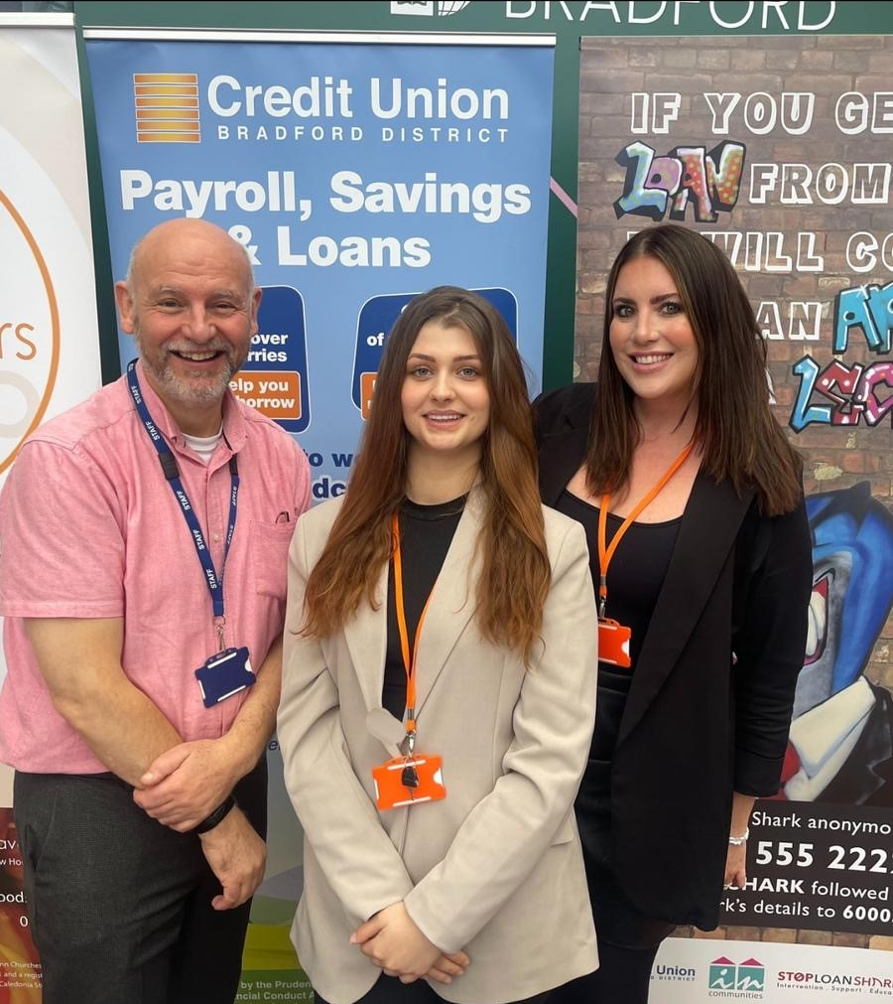
Meet The Team
Ian Brewer is EDI Community Development Lead with an international community development background. Ian leads on partnership community development projects to tackle poverty and manages employer engagement with its 34 payroll partner companies
Siobhan Graham is EDI Community Development Officer with a background in the NHS and runs the Community Development Projects as well works with Ian on payroll partnerships
Janka Brabcova is Marketing Apprentice working with the team to manage the website and creating marketing materials.

Slide 3

Bradford District Credit Union
History
1993 - Recession led to Bradford Council launching Industrial Credit Union
2005 - Extended to all residents of Bradford
2016 - Early adopter of online banking (app in 2018)
2016 - Council funded Financial Inclusion Officer
2019 - Extended to serve Kirklees & Craven (1.5 million people)
Membership Growth
1993 - 2016 = 3000 members
2016 - 2024 = 10,500 members
We help 3000+ financially excluded members
Provide ‘Faith Friendly’ ethical savings
How Much do 10,500 members Save?

Slide 4
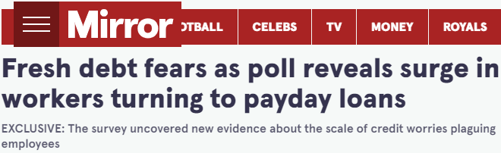
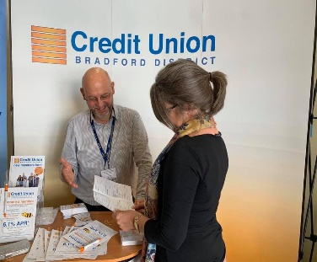
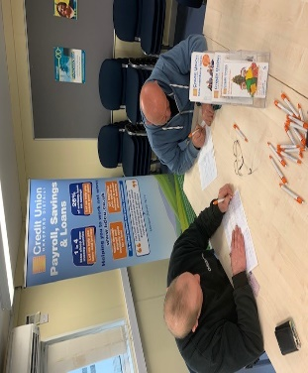
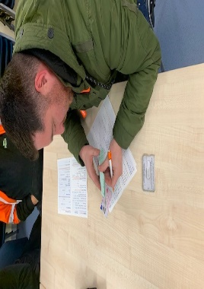
Workforce Payroll Savings
The Barriers
1 in 4 staff have major money worries
1 in 8 staff live in poverty unknown to employers
82% of workers have turned to high-cost credit
Alarming rise of Loan Shark use reported
Low credit score is a barrier to affordable loans
The Solutions
Financial Wellbeing improves performance
4,000 staff ‘Save & Borrow’ at 34 companies
Staff save £3.6 million and borrow £2.4 million
Loans build ‘Credit Scores’ alongside savings
Staff saving help us lend to financially excluded

Slide 5
















Helping 4000+ Staff Save & Borrow
At 34 Company Saving Schemes

Slide 6

Our Community Partners
Community Development Projects
and Case Studies

Slide 7
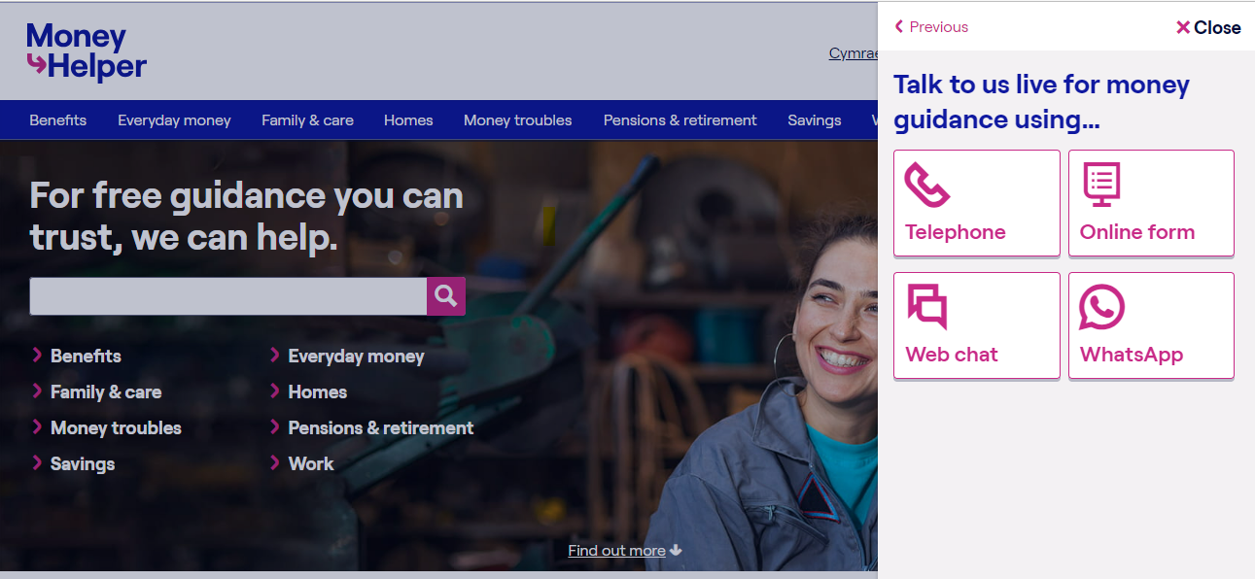

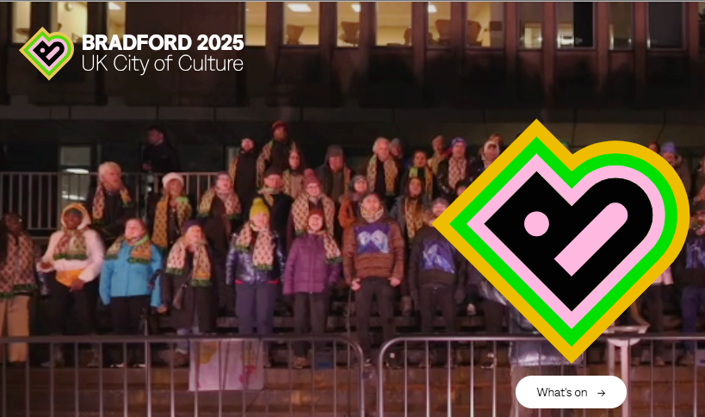

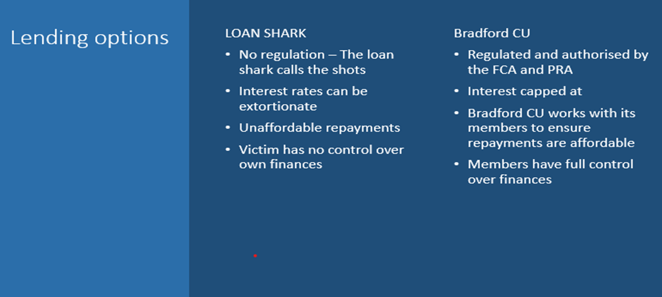

Key Partnerships
Notes:
BDCU is a preventative organisation
(Clockwise from Tackles Poverty):
1. **Tackles Poverty in Bradford, Kirklees, and Craven**
- Implements various projects aimed at supporting low-income families and reducing financial exclusion in these areas through targeted community initiatives and support services.
2. **Builds Community Resilience**
- Supports initiatives like FoodSavers and UniformSavers to tackle food insecurity and school uniform costs, promoting community resilience by ensuring basic needs are met.
3. **Promotes Savings Habits**
- Encourages regular savings through schemes such as Christmas Savers and Junior Savers, helping individuals and families build financial stability and plan for the future.
4. **Delivers Financial Education Webinars & Workshops**
- Offers comprehensive financial education through webinars and workshops, teaching financial management skills and raising awareness about the risks of high-cost lending.
5. **Offers Affordable Loans to Build Credit Score**
- Provides low-interest loans designed to help individuals avoid high-cost credit options and improve their credit scores, promoting long-term financial health.
6. **Payroll Savings and Loans for Staff**
- Enhances financial wellbeing for employees through payroll savings schemes and affordable loan options, making it easier for staff to save and borrow responsibly.
7. **Supports Mental Health**
- Partners with Mind in Bradford to integrate mental health support with financial wellbeing services, recognising the link between financial stress and mental health.
8. **Promotes Ethical Banking & ‘Faith Friendly’ Savings**
- Offers ethical banking options and faith-friendly savings products to meet the diverse needs of the community, ensuring inclusivity and ethical financial practices.
9. **Raises Gambling & Loan Sharks Awareness**
- Collaborates with NECA and Stop Loan Shark Team to educate and protect the community from the dangers of gambling and illegal lending, promoting safe financial practices.
10. **Leads Partnership Community Development Projects**
- Engages with local organisations to support community development initiatives and strengthen community ties, working together to build a more resilient and connected community.

Slide 8

Our Community Projects
Community Development Projects
and Case Studies

Slide 9
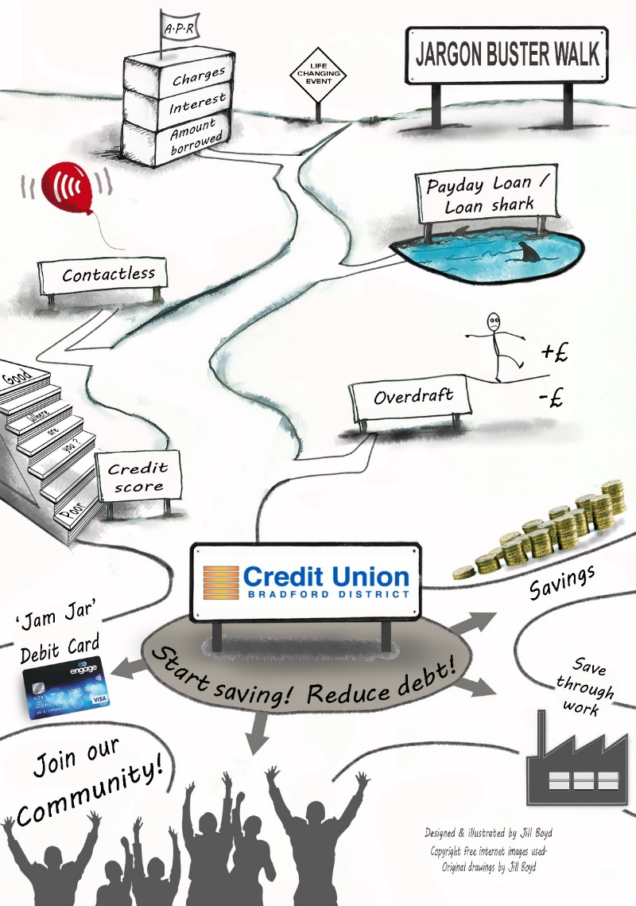
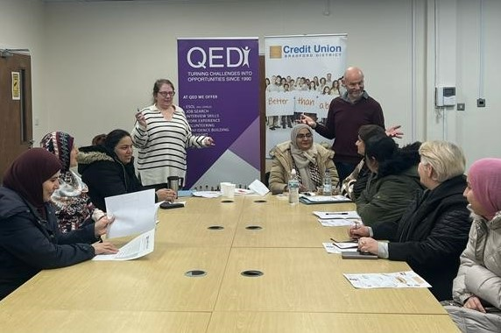
Financial Help and Workshops
‘Money SOS’ Workshop
What is APR?
PayDay and High Cost Lenders
Dangers of Loan Sharks
How Contactless Works
Overdrafts and direct debits
Improving your Credit Score
What the Credit Union offers

Slide 10
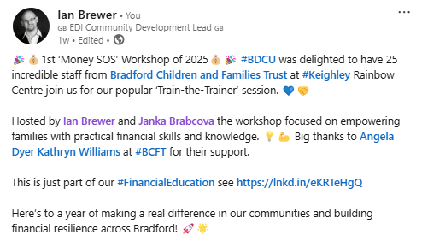
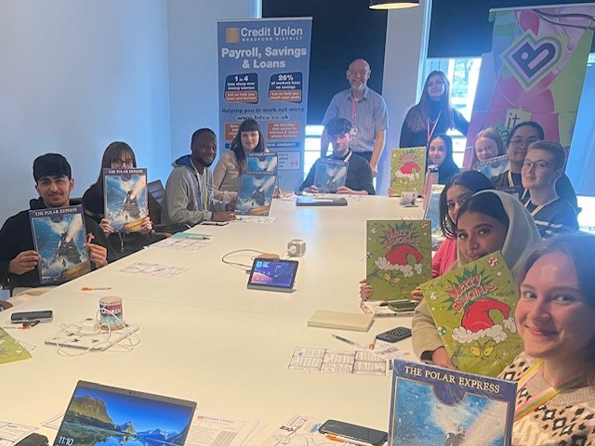
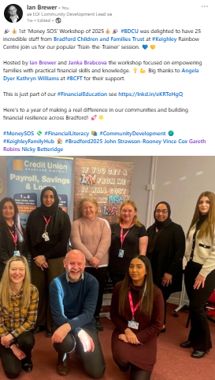
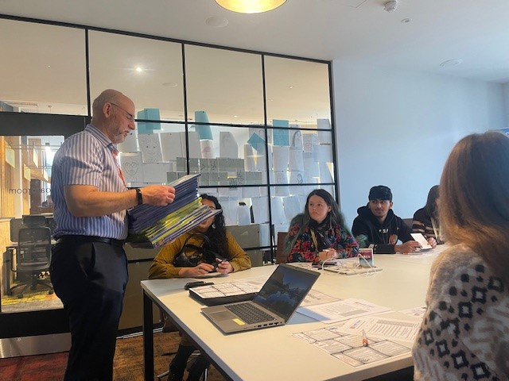
BD25 Apprentices Money SOS

Slide 11




Learning from America
‘Making financial inclusion a priority at your Credit Union is not only a “feel-good” thing to do, it’s an effective business strategy, its in our DNA.’ (Scott Butterfield ‘Your Credit Union Partner’ USA)
Community Development is at the heart of serving low-income communities that have limited access to safe financial services (Inclusiv)
Visit to USA in 1999 and 2022 to share the Bradford Model.
Continued collaboration since.

Slide 12
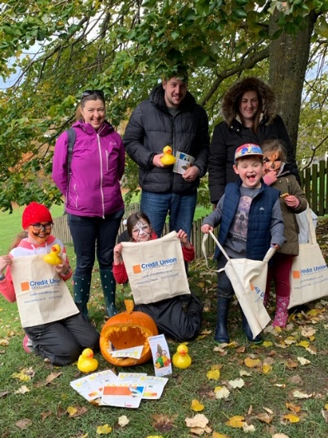
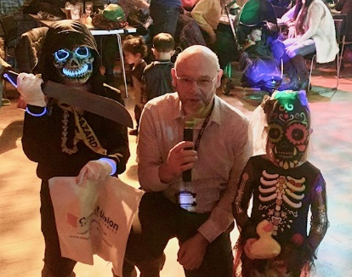
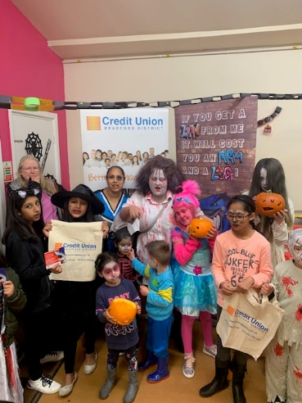
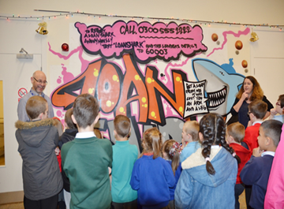
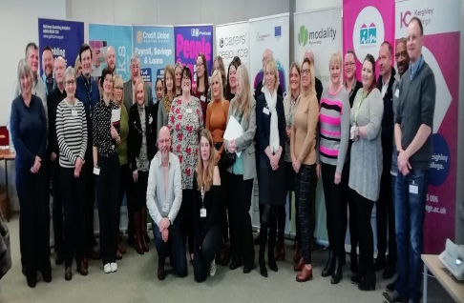
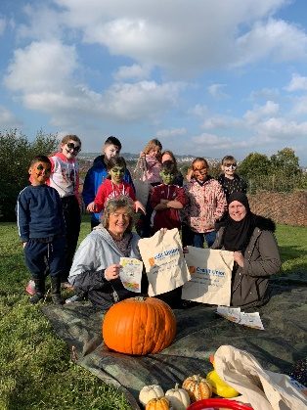
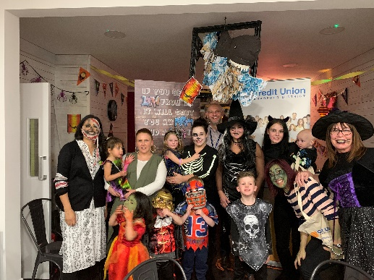
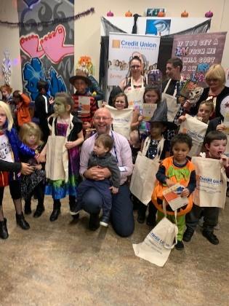
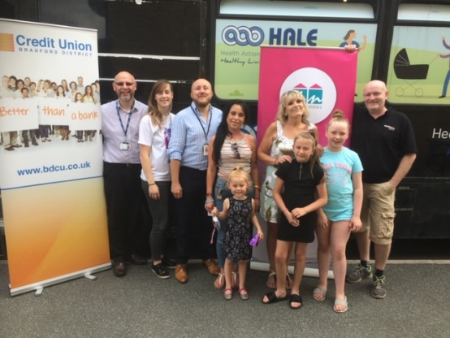
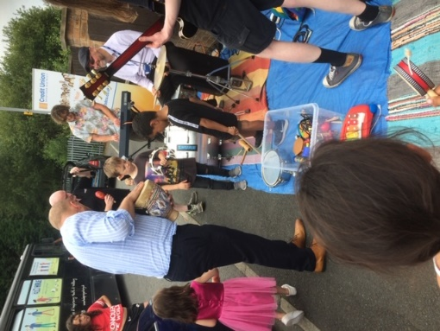
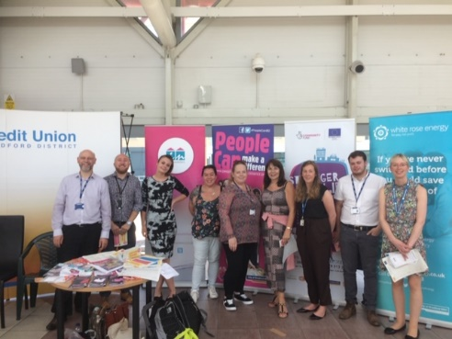
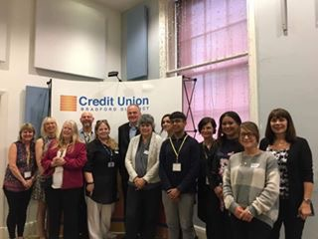
BDCU Led Partnership Projects
Conferences - Workshops - Road Shows

Slide 13
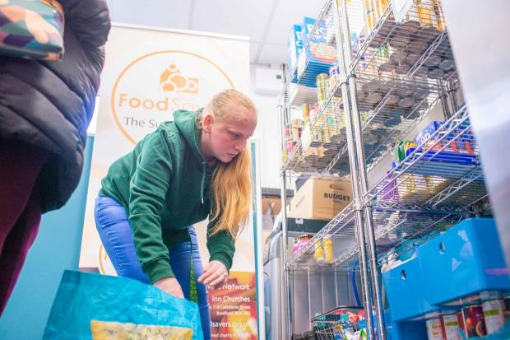
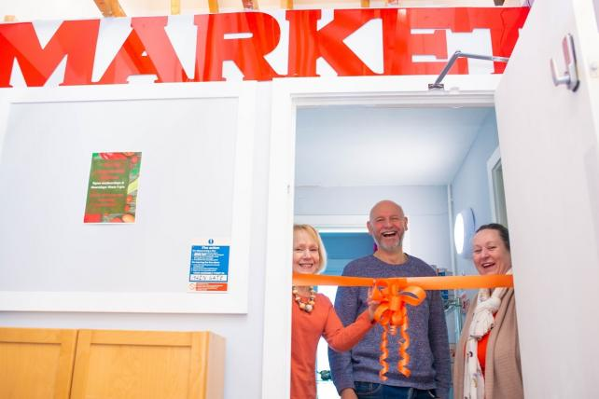
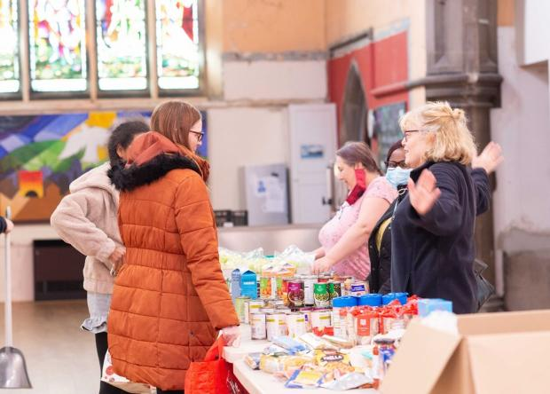
FoodSavers
Co-designed partnership project with Juli from Inn Churches to tackle food insecurity AND save into the credit union.
People pay £6 per bag of chosen food worth £30 and £1 goes into the BDCU.
‘Game Changer’ as many saved much more.
Results:
21 pantries
700 savers
Total Savings £52k!!!
West Yorkshire Roll Out

Slide 14



£120k Funding from WYCA and Bradford Council for two new projects:
£200 microloan scheme for people with poor credit score. Started as ‘Back to School Loan’ and now ‘Home Energy Bills Support Loan’
UniformSavers #3 to help more people save for school uniforms.

Slide 15
Benefits of a Credit Union:
Start a savings habit from your wage without missing it
Internet and Smartphone Banking, Debit Card & Post Office
Same day withdrawals to your bank
Access to affordable loans paid back via payroll
All our loans build ‘Credit Scores’ alongside savings
Christmas Savers – Budget for Christmas
Junior Savers – Save for a child or grandchild
Faith Friendly – Halal dividend NOT interest on savings
Ethical banking that supports your community
‘Money SOS’ Workshops and MoneyTips on our website
Regular newsletter and staff loan offers for staff

Slide 16
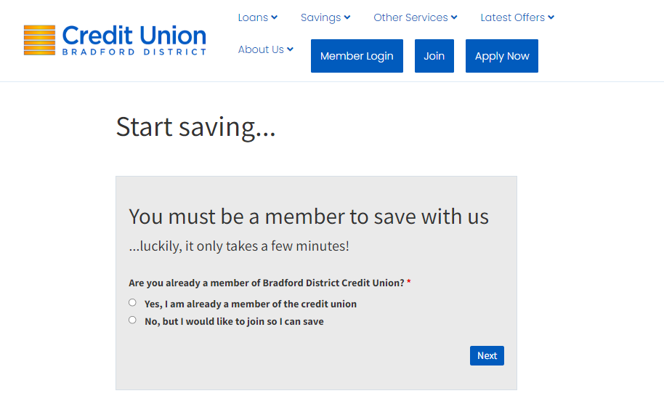
Join Today at www.bdcu.co.uk

Slide 17
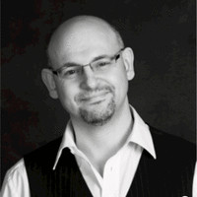
Contact
Join at www.bdcu.co.uk
Ian Brewer ian.brewer@bdcu.co.uk
Financial Inclusion Development Officer
City Hall Reception, Bradford, BD1 1HY
07533 547187

