Slide 1
Avoiding NHS Themed Scams
Rosie Dickinson – Local Counter Fraud Specialist

Slide 2
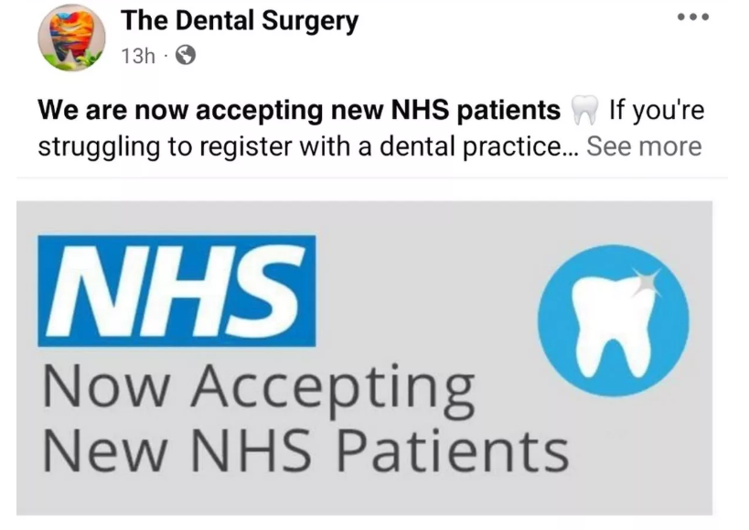
Social Media Dentist Scam

Slide 3
Avoiding the Scam
Use the NHS Find A Dentist site to register: https://www.nhs.uk/service-search/find-a-dentist/
Treat social media posts with suspicion
If you click a link and are asked for personal or financial details, stop and “think scam”. Get some advice if you’re not sure.

Slide 4
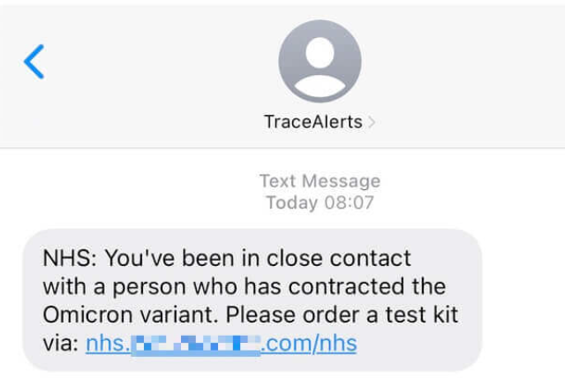
Text Message Scams

Slide 5
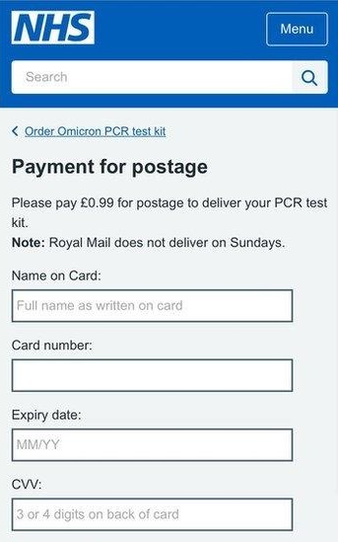

Slide 6
Email Scams
Sender’s details – not from an @nhs.net email account
Unexpected contact
Contains a link to an unknown website
Website asks for personal information and / or payment
Not from your local NHS service

Slide 7
Avoiding these Scams
Avoid clicking on links in emails and texts.
If in doubt contact the GP / dentist / hospital directly.
Stop and make checks if asked for personal info.

Slide 8
Scam Calls
“Hi, I’m calling from the NHS. I’ve got your referral….”

Slide 9
Avoiding the Scam
If in doubt about the caller, do not confirm or share your personal info.
End the call. If you think there’s a chance the call could have been genuine, wait 15 minutes or use a different phone to call your GP or local NHS service.
The NHS does not call people asking for payment. If you are asked for payment details, please end the call immediately.

Slide 10
Shifting Sands – Artificial Intelligence
Can make it harder to spot scams | Can do amazing things
Can be misused by criminals | Can help the NHS to move forward
Is changing how fraud happens | Will help us to fight fraud

Slide 11
Reporting NHS Fraud
Fraud against the NHS | Fraud against the public
NHS Counter Fraud Authority https://cfa.nhs.uk/report-fraud 0800 028 40 60 | Action Fraud https://www.actionfraud.police.uk 0300 123 20 40
If you think you have lost money to a scam, contact your bank as soon as possible.

