Slide 1
Physical Health

Slide 2
We believe better health is for everyone
Sovereign Health Care | 1873A

Slide 3
EVERYDAY HEALTH CARE

Slide 4
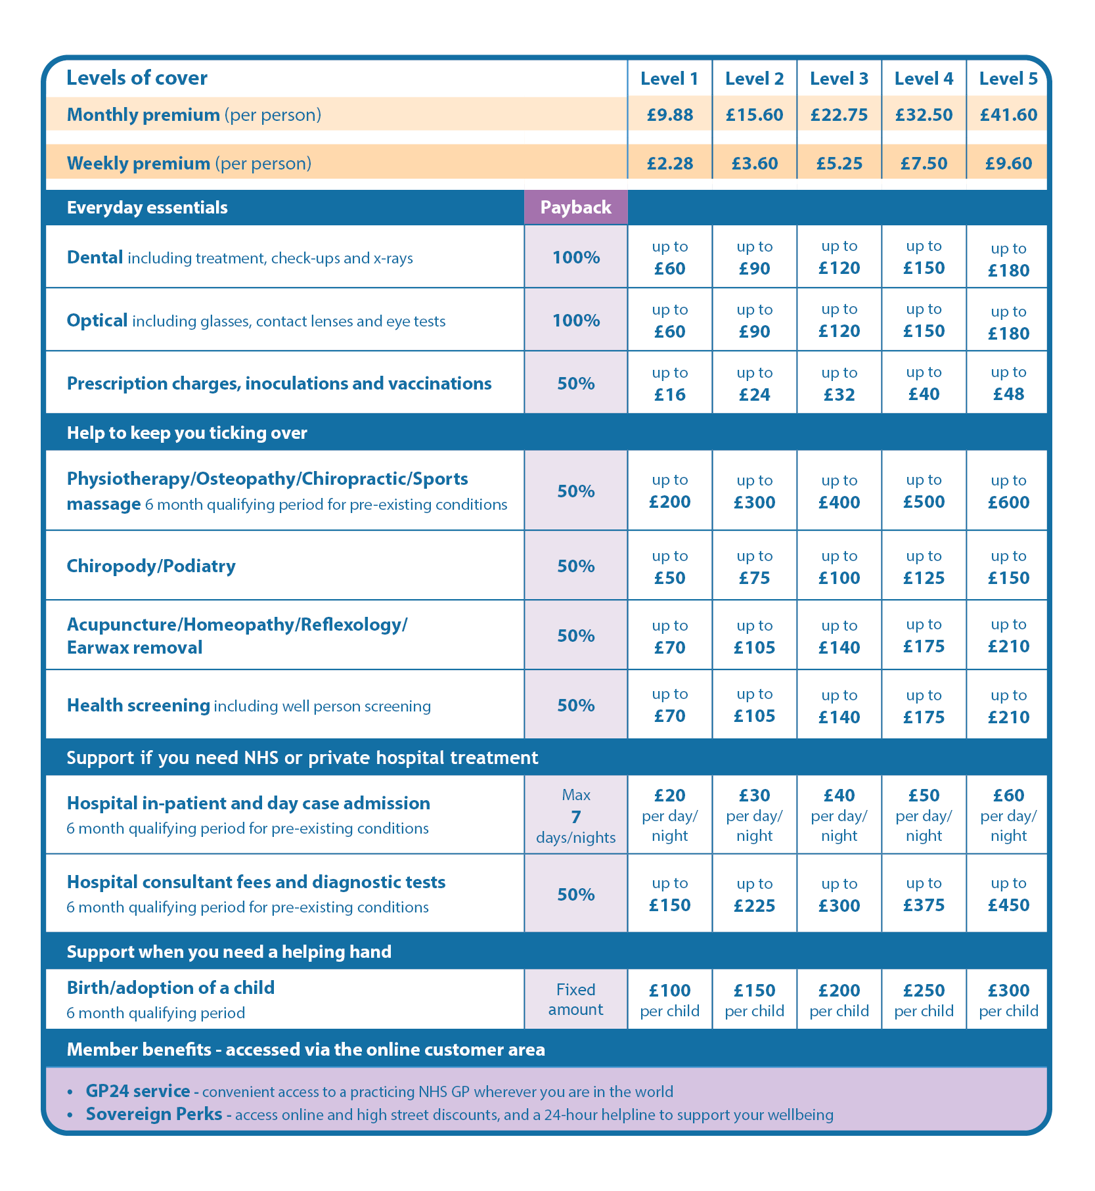
You pay and get a receipt with your name on it
1
Upload a photo or post your receipt to us
2
Receive money straight into your bank account
3

Slide 5
EVERYDAY HEALTH TIPS

Slide 6
Drink water
Physical performance
Brain performance
Bodily functions regulation (temperature/joints/nutrients)
Skin health
Notes:
1. Hydration: Water is crucial for maintaining hydration, which is vital for bodily functions like temperature regulation, joint lubrication, and nutrient transportation
2. Physical performance: Staying hydrated can significantly improve physical performance, especially during intense exercise or high heat
Even mild dehydration can impair physical abilities and increase fatigue2
3. Brain function: Proper hydration is essential for brain function. Studies show that even mild dehydration can impair mood, memory, and cognitive performance
.4. Detoxification: Water helps flush out toxins from the body through urine and sweat, supporting kidney function and overall health
5. Skin health: Drinking enough water can improve skin health by maintaining its elasticity and reducing the risk of skin disorders

Slide 7
WATER
NOT COFFEE

Slide 8
Off at 9pm…
Blue light impacts sleep-wake cycles
Fall asleep faster
Reduce stress and anxiety
Boost morning alertness
Notes:
1. Reduces blue light exposure: The blue light emitted by phone screens can suppress melatonin production, the hormone responsible for regulating sleep-wake cycles
This makes it harder to fall asleep and can disrupt your circadian rhythm1
2. Improves sleep quality: Turning off your phone an hour before bed can help you fall asleep faster and improve the overall quality of your sleep
This is because it reduces mental stimulation and allows your brain to wind down2
3. Enhances REM sleep: Avoiding phone use before bed can increase the amount of REM sleep you get, which is crucial for cognitive functions like memory and learning
.4. Reduces stress and anxiety: Constant notifications and the urge to check your phone can increase stress and anxiety levels. Turning off your phone helps create a more relaxing bedtime environment
.5. Boosts morning alertness: Better sleep quality leads to improved alertness and cognitive function the next day, making you more productive and focused
.

Slide 9
BOOST
EYE HEALTH

Slide 10
Stretch
Increase flexibility
Improve posture
Protect against joint pain
Notes:
1. Improves cardiovascular health: Regular walking can help lower blood pressure, reduce LDL (bad) cholesterol, and strengthen your heart
This reduces the risk of heart disease and stroke1
2. Enhances mood and reduces stress: Walking releases endorphins, which are natural mood lifters
It also helps reduce stress levels and can improve overall mental health1
3. Supports weight management: Walking is a low-impact exercise that can help burn calories and contribute to weight loss
It's an easy way to increase your daily physical activity without needing special equipment1
4. Boosts metabolism: Even short walks can increase your metabolism, helping your body process food more efficiently
5. Reduces joint pain: Regular walking can improve joint mobility and reduce pain, even for those with arthritis
It helps keep your joints flexible and strengthens the muscles around them2

Slide 11
MSK HEALTH

Slide 12
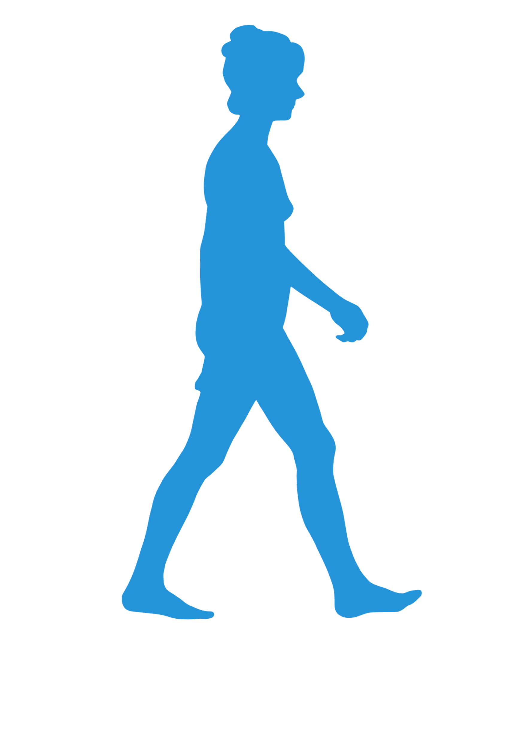
Walk
Improve cardio strength
Enhance mood and reduce stress
Boost metabolism / Reduce weight
Reduce joint pain
Notes:
1. Improves cardiovascular health: Regular walking can help lower blood pressure, reduce LDL (bad) cholesterol, and strengthen your heart
This reduces the risk of heart disease and stroke1
2. Enhances mood and reduces stress: Walking releases endorphins, which are natural mood lifters
It also helps reduce stress levels and can improve overall mental health1
3. Supports weight management: Walking is a low-impact exercise that can help burn calories and contribute to weight loss
It's an easy way to increase your daily physical activity without needing special equipment1
4. Boosts metabolism: Even short walks can increase your metabolism, helping your body process food more efficiently
5. Reduces joint pain: Regular walking can improve joint mobility and reduce pain, even for those with arthritis
It helps keep your joints flexible and strengthens the muscles around them2
.

Slide 13
FOOT HEALTH

Slide 14
Eggs are a superfood
Complete protein with 9 amino acids
7g protein (you need c50g per day)
Improve muscle health
Improve brain function
Notes:
1. Eggs are a complete protein: They contain all nine essential amino acids that the body needs
This makes them an excellent source of high-quality protein.
2. Protein content: One large egg provides about 6-7 grams of protein
This is significant considering the average sedentary adult needs about 46-56 grams of protein per day2
3. Nutrient-rich: Besides protein, eggs are packed with vitamins and minerals like vitamin B12, vitamin D, iron, selenium, and zinc
These nutrients are crucial for immune function, brain health, and red blood cell production1
.4. Muscle health: The protein in eggs supports skeletal muscle health and helps protect against muscle loss (sarcopenia)
.5. Weight management: Eating eggs can help decrease appetite and reduce caloric intake, which can aid in weight loss

Slide 15
HEALTH CHECK

Slide 16
LOOK AFTER YOURSELF
BUT HAVE THE PROTECTION
OF THESE BENEFITS

Slide 17
OVER
£7m
DONATED

Slide 18
QUESTIONS?

