Slide 1
The Local Government Pension Scheme
Sheryl Clapham
West Yorkshire Pension Fund

Slide 2
Why are pensions important?
Guaranteed income in later life
  Payable for the rest of your life once claimed
  Increased each year by the cost of living
State provision is modest
Pensions not the only way of saving, but it is accessible to everyone and your employer contributes a significant amount
Notes:
Government are encouraging people to have their own pension and not rely on the state pension entirely

Slide 3

The State Pension
Payable from age 66 or 67 currently, but moving to 68 for ‘younger people’
In 2025 a standard basic State Pension is £230.25 per week (approx. £11,973 per year)
Any LGPS pension savings will be paid on top of the State Pension when you retire and reach State Pension Age (SPA)

Slide 4
What do you get from WYPF
Pension payable for rest of your life
Option to take a tax free Lump sum
Life protection in the form of a
Death Grant
Ill health retirement protection
Normal Pension Age = SPA, but payable from age 55 with reductions

Slide 5
Is it good value for money?
On average an LGPS member’s pension will have paid back all the cost of contributions within 3 ½ years of first claiming their pension
The average length of time a pension is in payment is over 15 years

Slide 6
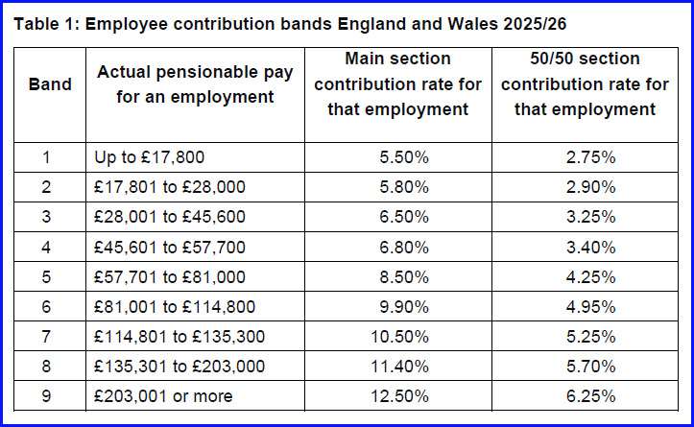
How much does it cost?
Contribution percentage bands based on earnings
*2024/2025 rates

Slide 7
How much does it cost?
Tax relief on contributions so the headline figure less than it looks (if you pay tax)
Feeling the pinch of the current cost of living crisis?
  Putting off joining or thinking of opting out?
Have you considered the 50/50 section?

Slide 8

50/50 section
Pay half the rate, build up half the pension
Keep full ill health and death in service protection
Temporary solution, will be brought back in to the main section every 3 years
50/50 form – available form our website
Opt in form – speak to your employer to get one

Slide 9
Two ways to pay extra
Additional Pension Contributions (APC’s)
Additional Voluntary Contributions (AVC’s)
All payments are deducted directly from your salary attracting tax relief and maximums apply
See our website for more details

Slide 10

Interested if finding out more?
Visit our website
Watch the bitesize videos
Attend our webcasts for pension awareness week (9 – 15 Sept)
Engage with your LGPS pension – more sessions coming soon
Pre-retirement & financial planning seminars available with Affinity Connect
https://www.wypf.org.uk/lgps-members/lgps-knowledge-hub/events/

Slide 11


Online member portal
Available for active contributors, deferred members and pensioners
  See you record, download your
  documents and update your details
Active members can now run their own pension forecast

Slide 12


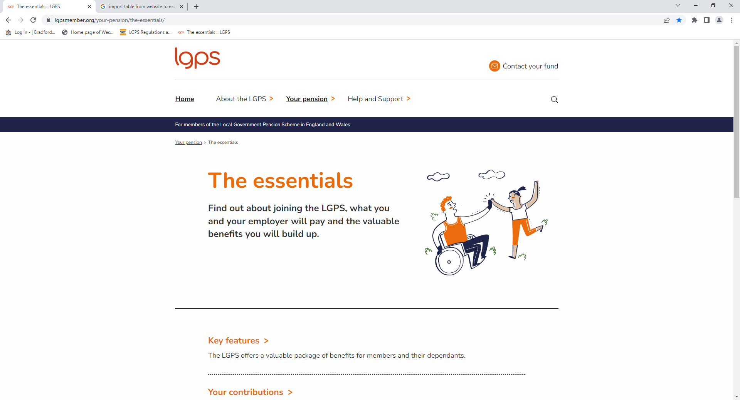
Useful Websites
https://www.moneyhelper.org.uk/en#
https://www.retirementlivingstandards.org.uk/
www.lgpsmember.org

Slide 13




SUPPORT IS AVAILABLE NOW
If you have any queries please contact our Contact Centre
Mailbox
pensions@wypf.org.uk
Telephone
01274 434999
WYPF website – New Live Chat feature
www.wypf.org.uk
Notes:
The contact details you can use are displayed on the slide.
Finally we have a wealth of information on our website under the employer section at wwww.wypf.org.uk

Slide 14
Disclaimer
This presentation is issued by West Yorkshire Pension Fund (the fund) to assist the stakeholders and partners associated with West Yorkshire Pension Fund.
This information has been prepared on the funds current understanding of the scheme regulations; therefore it should not be treated as a complete authoritative statement of the law.
Users may wish, or will need, to take their own legal advice on the interpretation of any particular regulations.
No responsibility whatsoever will be assumed by the fund for any liability, financial or otherwise, incurred by stakeholders relying on this statement.
The fund does not accept any responsibility for reliance on the contained, or referred to, in this guidance.

Slide 15
Thank you
West Yorkshire
Pension Fund

